Slide 1
the College of Arts and Science
School of Learning and Creativity
Art, Creativity and the Human Brain
Kenneth Wesson Educational Consultant: Neuroscience San Jose, CA
kenawesson@aol.com

Slide 2
Making your thinking visible

Slide 3
What is the difference between
knowing and understanding?
If students have a single exposure (lecture, video, reading, etc.) to a concept, they should be able to respond correctly on a test.
Important distinctions must be made between what one
1. hears vs. recognizes
2. hears vs. understands
3. recognizes vs. remembers
4. remembers vs. understands
5. understands vs. able to reproduce
6. knows vs. knows how to apply (practices)
Examples??

Slide 4
What are the distinctions that we should make between one’s ability to
recognize,
recall, or
reproduce information on a given concept or topic?

Slide 5
Popular Icons: 1950 - 1990
Recognition, Recall and Reproduction
Marriott International Hotels | Shell | Nike | Playboy | Pepsi-Co | Atari
Sporcle, Inc. | Toyota | Prudential Financial | AT&T | Chrysler | Adobe
Deere and Company | McDonald's Corporation | United Airlines | Honda | Safeway | Yahoo
Chevron | Motorola | Mercedes-Benz | American Airlines | America Online (AOL) | Mazda
Hilton Hotels | Taco Bell | Volkswagen | The Boeing Company | General Mills | Guinness
Sprint Nextel | Anheuser- Busch | Audi | Microsoft Windows | DreamWorks SKG | Apple

Slide 6
Popular Icons: 1950 - 1990
Recognition, Recall and Reproduction

Slide 7
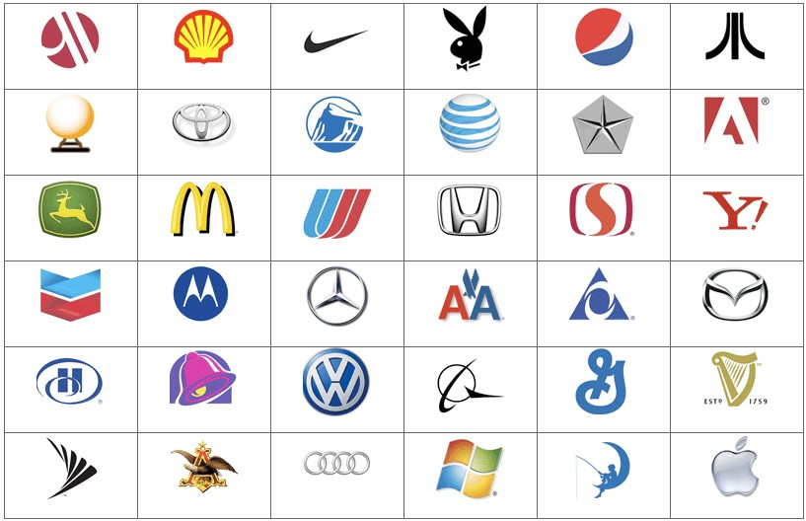
Popular Icons: 1950 - 1990

Slide 8
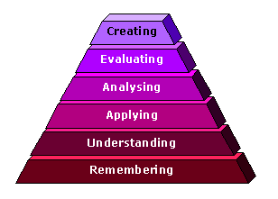
Revised Taxonomy
Revised by Anderson & Krathwohl (2001)

Slide 9
Functional Fixedness
Karl Duncker - The mental blocks that cause people not to see another way of using an object or using it in a new way.
Task: Can you link the two rubber rings together so that they form a figure “8”?
Materials: Two rubber rings and a candle (no matches)

Slide 10
Teaching today’s thinkers and learners
to become
tomorrow’s innovators

Slide 11
What About the “A” in STEAM?
The Power of Visualization
Seeing With the Mind’s Eye

Slide 12
Why is Reaction Time Important?
The species that passed the test of natural selection were those that figured out how to save just a few milliseconds in avoiding dangers and taking advantage of opportunities (capturing prey, anticipating the actions of predators, etc. - food, fighting, and fleeing) survived and passed their genes forward to the next generation.
Survival depended on forecasting the movement and behavior of other individuals, other animals, other objects in future events (which depended on learning and memory - proactive recognition and responses to identifiable patterns -- mentally simulating the future – “mental constructs”).

Slide 13
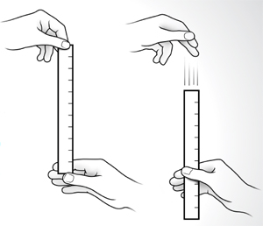
The Power of Visualization
A = Awesome
270 = m.p.h.
B = Brilliant

Slide 14
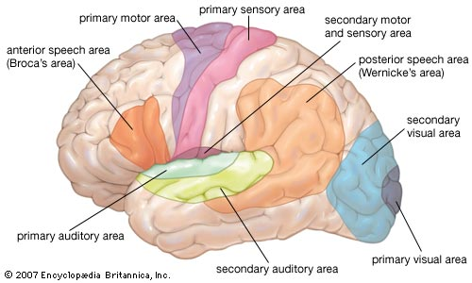
Using your Reflexes
(Each takes 0.05 – 0.1 sec.)
Eyes → sight (2) visual cortex – vision → (3) association cortex - meaning → (4) frontal lobes – plan of action → (5) PfC – prepares response → (6) motor cortex – takes an action
6
3
5
2
4

Slide 15
Reflexes: In the Mind
(Each takes 0.05 – 0.1 sec.)
PfC – prepares response (2) Ears → hearing → (3) motor cortex – takes an action
3
1
2

Slide 16
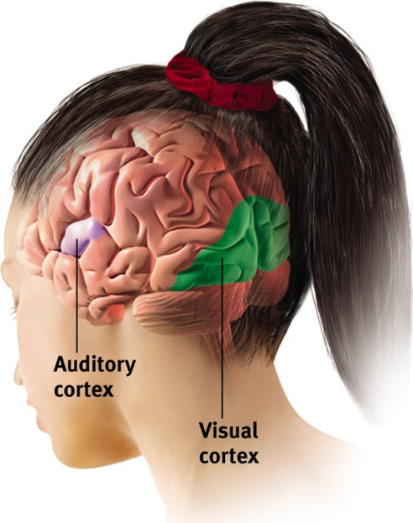
Reflexes: Visualization
(Each takes 0.05 – 0.1 sec.)
Eyes → sight (2) visual cortex – vision → (3) association cortex - meaning → (4) frontal lobes – plan of action → (5) PfC – prepares response → (6) motor cortex – takes an action
6
3
5
2
4

Slide 17
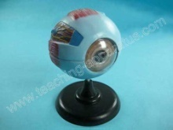
The Brain-based Classroom:
Making Connections
We say that our eyes "see” - vision is accomplished by specialized brain cells that convert light from the external world into an elaborate neural code for encoding, processing, storage and retrieval.
Beginning at birth, the eyes and the brain undergo a daily training regimen for understanding art and images well before any thoughts of school
For millions of years, vision has been our primary method of experiential data collection. Nearly 80% of the information we use enters our sensory world via the eyes -- our major doorway to initial discovery

Slide 18
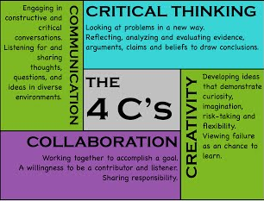
21st Century Skills

Slide 19
Gonzales, P., Williams, T., Jocelyn, L., Roey, S., Kastberg, D., and Brenwald, S. (2008). Highlights From TIMSS 2007: Mathematics and Science Achievement of U.S. Fourth- and Eighth-Grade Students in an International Context (NCES 2009–001 Revised). National Center for Education Statistics, Institute of Education Sciences, U.S. Department of Education. Washington, DC.

Slide 20
The US Is Prospering Because of Creativity
The US is responsible for producing 28% of the world’s economic output with less than 5% of the world’s population.
Business Week ranks 8 US firms in the top 10 “most innovative” companies in the world.
America has a gross domestic product close to $13 trillion and has contributed one-third of the growth in global output over the most recent 15-year period.
U.S. universities employ 70% of the world’s Nobel Laureates.
Our public and private schools are the #1 resource in the world for producing creative minds.

Slide 21
STEAM: Making Connections
Global catastrophes → $$ & medical equipment → 3rd World countries → incubators from WHO/international relief orgs. → when the incubators are no longer operational (no parts or repair expertise) → abandoned/trashed (1 dz.= $500K) → “Design That Matters” → more reliable, less complicated/less expensive incubator (no expensive spare parts/no highly-trained repair tech).
NeoNurture (Dr. Jonathan Rosen, Rhode Island School of Design students) → incubator made out of recycled and spare car parts: headlights (heat), dashboard fans, air- intake filters (air circulation) and batteries (= easy to repair/replace) power supply → comparable to expensive incubators in function and results.

Slide 22
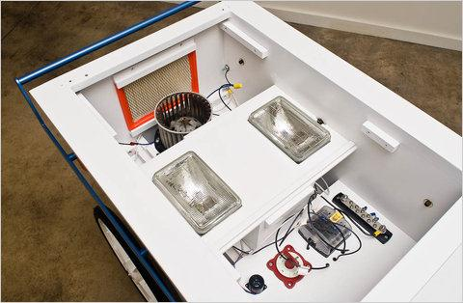
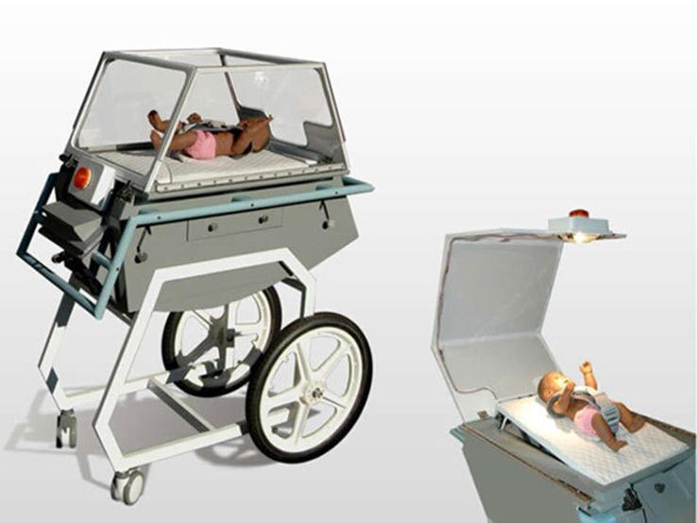
The 50 Best Inventions of the Year: NeoNurture Incubator
Coffee, Coke, and cigarettes, and old car parts
Spare/old automobile parts → re-combined and re-purposed into a life-saving neonatal chamber device
Visual spatial thinking: How do we develop students who can look at spare car parts and see an incubator by creatively re-combining those parts into a new and useful product?

Slide 23
Electromagnetism
Magnetism
Electricity

Slide 24
Electromagnetism
What is an electrical circuit?
How would you construct a circuit with one wire?
Can you make a circuit with two wires?
Construct the circuits
Draw a representational model of each circuit

Slide 25
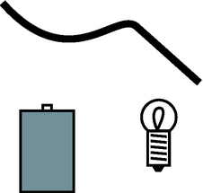
NGSS
What is needed to light a bulb?
Use a D-cell and wires to try to light a bulb.
Circuit – “Circle”

Slide 26
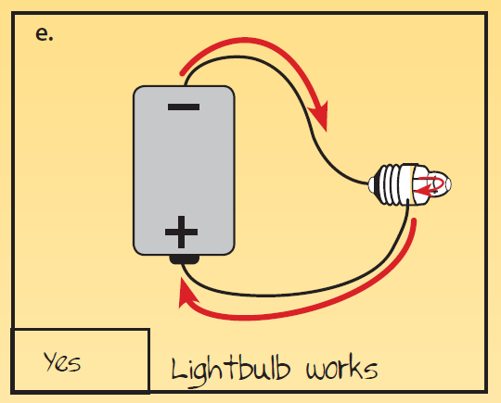
Energy: Circuit Pathway

Slide 27
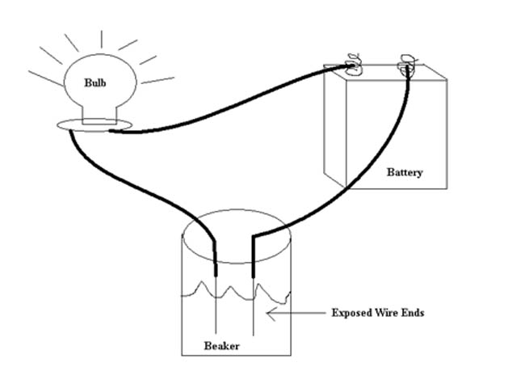
Will this bulb light if the connection is in water?

Slide 28
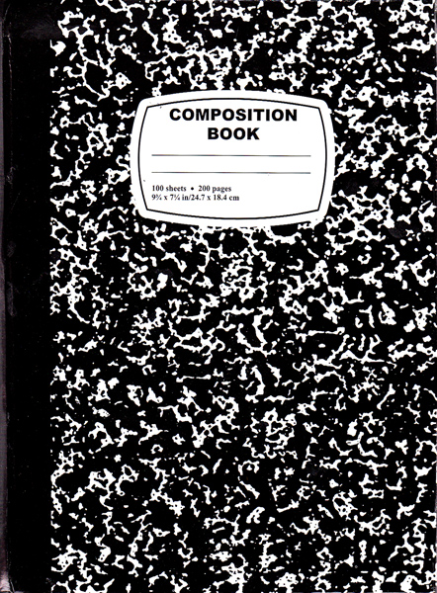
CER: Claims, Evidence, and Reasoning
Making claims based on observations, and using data collected as evidence (reasoning and sense-making: The CCSS refer to this strategy as CER = Claim, Evidence, and Reasoning that are used in constructing explanations)

Slide 29
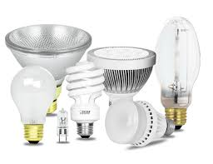
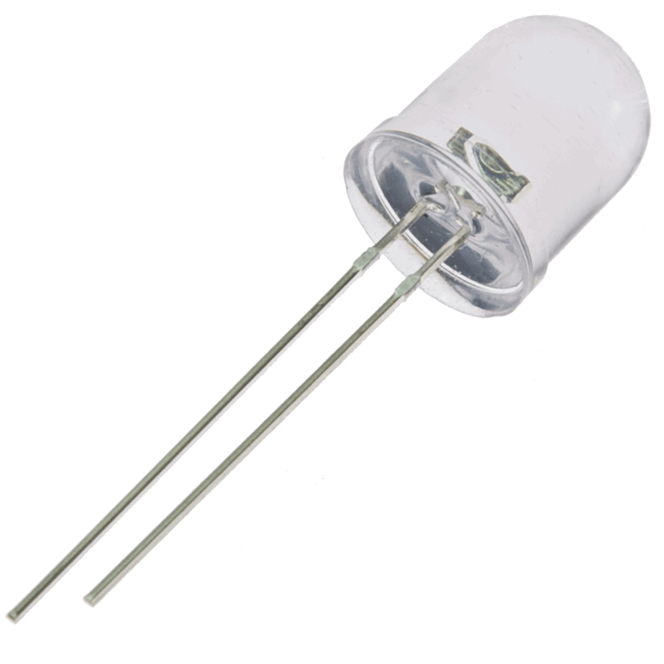

Slide 30
Engineering Challenge:
Creating solutions to problems (the work of engineers who “engage in a systematic practice of design to achieve solutions particular human problems” - NRC, A Framework for K-12 Science Education, 2012, page 11)
The success of their solution(s) is determined by how well or satisfactorily it solves the problem (criteria)
Solutions are limited by constraints (e.g., the available materials, time, budget/costs, tools, conditions, etc.,) and solutions do not occur in a “light bulb experience.” Instead, they require a deliberate, thoughtful, systematic design process.
LED (“Light-up”) Greeting Card

Slide 31
Engineering Challenge:
LED (“Light-up”) Greeting Card
1. Criteria: Make a greeting card that includes an LED “light” connected to an electrical circuit that you can control.
2. Constraints: (a) use only the materials provided, (b) you can design your greeting card with a picture, a greeting, and/or a poem that incorporates a light that can be controlled, and (c) your group will have 25 minutes to design, assemble/construct, and test your greeting card .
Step #1 - Research the problem/challenge
Step #2 - Brainstorm solutions
Step #3 - Design (draw/illustrate) what the proposed solution would look like
Step #4 - Build a prototype of the design solution
Step #5 - Test the prototype
Step #6 - If improvements are needed to meet the stated criteria, revise or refine the design/drawing
Step #7 – Build the new (“new and improved”) prototype – an “optimized solution”
Step #8 Test the revised solution

Slide 32
Engineering Challenge:
LED (“Light-up”) Greeting Card
Materials: 1/4" conductive copper tape
2 LED lights (red and white)
“coin-shaped” Cell Battery
Paper
Scotch tape
Scissors
Rulers
Pencils, markers or colored pencils

Slide 33
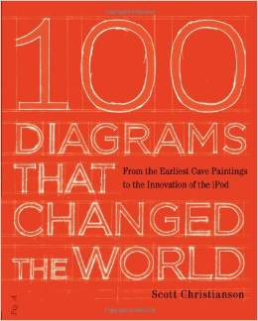
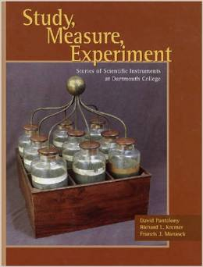
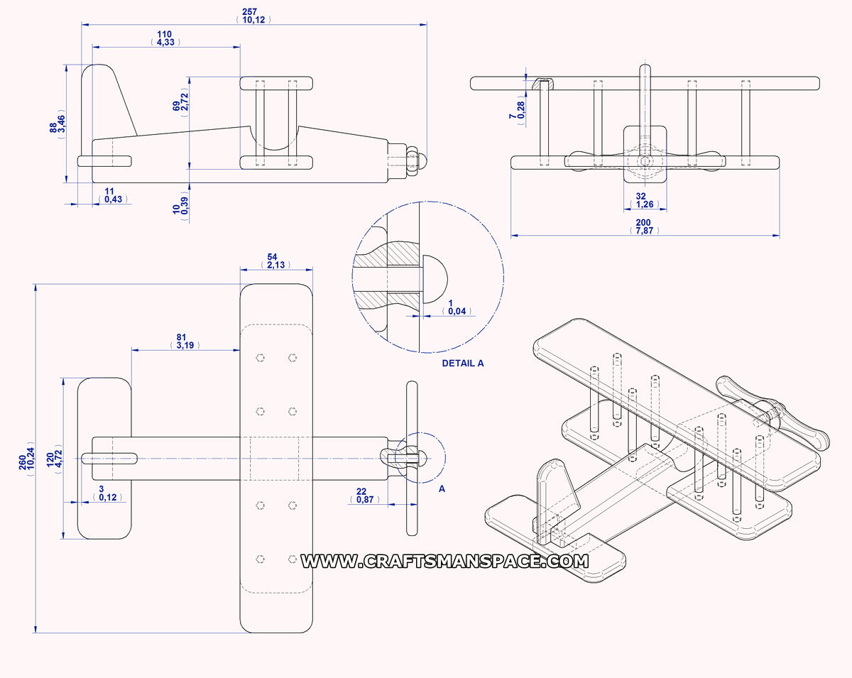
Design and Engineering = Art
All ideas begin with a vision/visual image (a mental picture → drawing).
All engineering begins with a design (→ diagram graphic representation of the initial idea).

Slide 34
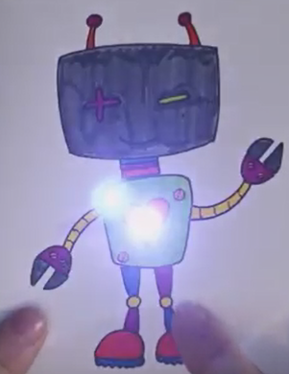
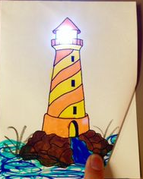
Sample LED Greeting Cards

Slide 35
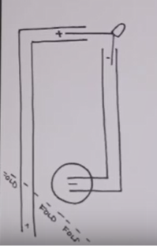
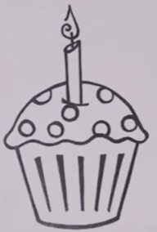
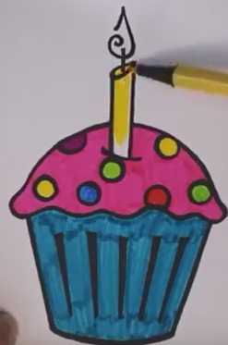
Back of card (circuit design)
Draft of front
Front of card

Slide 36
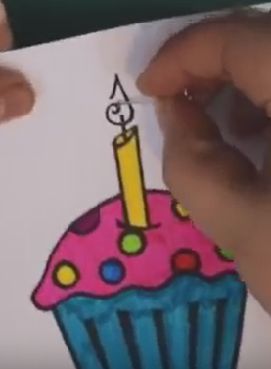
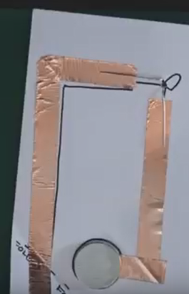

Slide 37
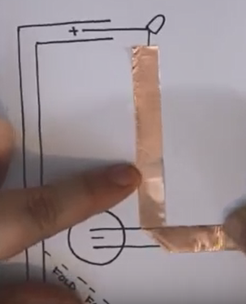
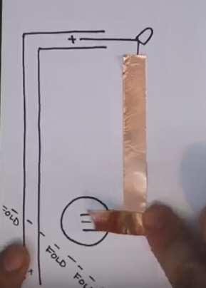
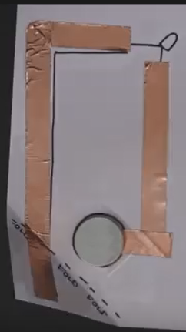

Slide 38
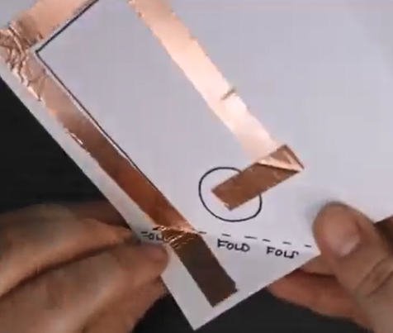
LED (“Light-up”) Greeting Card
Step #1 - Research the problem/challenge
Step #2 - Brainstorm solutions
Step #3 - Design (draw/illustrate) what the proposed solution would look like
Step #4 - Build a prototype of the design solution
Step #5 - Test the prototype
Step #6 - If improvements are needed to meet the stated criteria, revise or refine the design/drawing
Step #7 – Build the new (“new and improved”) prototype – an “optimized solution”
Step #8 Test the revised solution

Slide 39
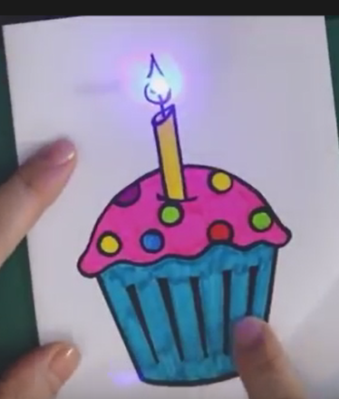
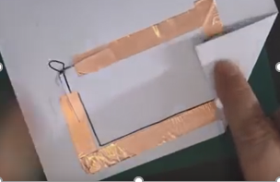

Slide 40
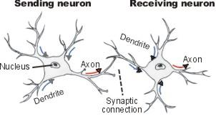
Making Connections:
Make a simple circuit with an LED and a lithium 3V battery
+
(fold)
_
another continuous piece of copper tape (short)
- - - - - - - - - - - - - - - - - -
Battery
_
LED (place each lead so it touches one piece of copper tape)
Leave a gap separating the 2 pieces of copper tape
+
- negative
+ positive
use 1 continuous piece of copper conductive adhesive tape (long)
sciencemaster
© 2016

Slide 41
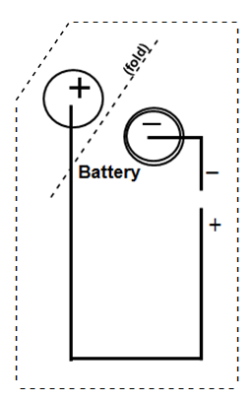
Making Connections:
Make a simple circuit with an LED and a lithium 3V battery
sciencemaster
© 2016

Slide 42
LED (“Light-up”) Greeting Card
Steps
#1 - Sketch the front of your card
Brainstorm with your colleagues and decide on a card design.
Determine where you want the LED to be incorporated into the design. (When connected, the LED light will glow at that location).
Make a pinprick hole where the leads of the LED light will stick through.
Step #1 - Research the problem/challenge
Step #2 - Brainstorm solutions
Step #3 - Design (draw/illustrate) what the proposed solution would look like
Step #4 - Build a prototype of the design solution
Step #5 - Test the prototype
Step #6 - If improvements are needed to meet the stated criteria, revise or refine the design/drawing
Step #7 – Build the new (“new and improved”) prototype – an “optimized solution”
Step #8 Test the revised solution

Slide 43
LED (“Light-up”) Greeting Card
Steps
Step #1 - Research the problem/challenge
Step #2 - Brainstorm solutions
Step #3 - Design (draw/illustrate) what the proposed solution would look like
Step #4 - Build a prototype of the design solution
Step #5 - Test the prototype
Step #6 - If improvements are needed to meet the stated criteria, revise or refine the design/drawing
Step #7 – Build the new (“new and improved”) prototype – an “optimized solution”
Step #8 Test the revised solution
#2 – Review the parallel circuit design (provided).
Plan the design and orient the placement of the circuit so that the LED will be incorporated into your picture. (You will be adding the copper tape and a battery later).
Orient the circuit diagram so that the position of the LED light is exactly where your light will be in the picture (on the front).

Slide 44
LED (“Light-up”) Greeting Card
Steps
#3 – Attach the conductive copper tape (your circuit)
Cut the copper tape into two pieces that are approximately ½ inch longer than the two strips on your circuit diagram.
Peel off the backing of the copper tape and apply it to your circuit design on the card.
At each corner, “make the turn” by folding the copper tape in the opposite direction that you want to go, then you can fold back in the desired direction.
One end of the copper tape should reach out to the center of the space where the battery will be positioned. (The folded corner will eventually act as our switch.)
Step #1 - Research the problem/challenge
Step #2 - Brainstorm solutions
Step #3 - Design (draw/illustrate) what the proposed solution would look like
Step #4 - Build a prototype of the design solution
Step #5 - Test the prototype
Step #6 - If improvements are needed to meet the stated criteria, revise or refine the design/drawing
Step #7 – Build the new (“new and improved”) prototype – an “optimized solution”
Step #8 Test the revised solution

Slide 45
LED (“Light-up”) Greeting Card
Steps
Step #1 - Research the problem/challenge
Step #2 - Brainstorm solutions
Step #3 - Design (draw/illustrate) what the proposed solution would look like
Step #4 - Build a prototype of the design solution
Step #5 - Test the prototype
Step #6 - If improvements are needed to meet the stated criteria, revise or refine the design/drawing
Step #7 – Build the new (“new and improved”) prototype – an “optimized solution”
Step #8 Test the revised solution
#4 – Connect the battery
Place the coin-shaped battery onto its place on the diagram and apply scotch tape to just 1/3 of the battery to hold it in place.
The bottom of the battery will cover the end of the copper tape (with the “ - ” side down). Make sure the “ + ” sign is on the top.

Slide 46
LED (“Light-up”) Greeting Card
Steps
Step #1 - Research the problem/challenge
Step #2 - Brainstorm solutions
Step #3 - Design (draw/illustrate) what the proposed solution would look like
Step #4 - Build a prototype of the design solution
Step #5 - Test the prototype
Step #6 - If improvements are needed to meet the stated criteria, revise or refine the design/drawing
Step #7 – Build the new (“new and improved”) prototype – an “optimized solution”
Step #8 Test the revised solution
#5 - Add your LED light
Make a pinprick hole through the paper where you want to place the light and stick the leads (the skinny metal “legs” on the LED light) through the paper.
Place the longer lead of the LED light on the “+” side of the circuit diagram and the shorter lead on the “ – ” side of the diagram.
Use scotch tape to secure the leads to the copper tape.

Slide 47
LED (“Light-up”) Greeting Card
Steps
Step #1 - Research the problem/challenge
Step #2 - Brainstorm solutions
Step #3 - Design (draw/illustrate) what the proposed solution would look like
Step #4 - Build a prototype of the design solution
Step #5 - Test the prototype
Step #6 - If improvements are needed to meet the stated criteria, revise or refine the design/drawing
Step #7 – Build the new (“new and improved”) prototype – an “optimized solution”
Step #8 Test the revised solution
#6 – Make the on-off “switch” for the connection
Fold the corner piece of the diagram to complete the circuit and the light for your card should come on.
(If your light does not come on, troubleshoot your circuit for a break in the connection, or leads for the “legs” attached to the wrong copper strip).

Slide 48
CCSS Writing and Learning
Students should appreciate that learning was the ultimate goal not to memorize the discreet facts and vocabulary words.
Students should find that the new vocabulary is so useful and familiar that they begin to use the new vocabulary words naturally when they:
(a) explain their work
(b) reflect on their work
(c) describe what they do personally during the active learning process, and when they communicate their findings in the future.

Slide 49
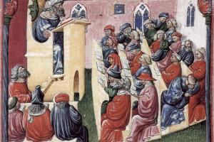
Teaching Thinking vs. Lecturing
Who is more inclined to say the others “talk too much!” – Teachers or students?
Lecturing, the 2nd oldest form of teaching, comes from the Latin lecture, meaning "to read aloud.”
Books - the earliest form of ed-tech (few and $$) → combined with the lecture (“Audi – torium” not a “Think-a-torium”)

Slide 50
Standardized testing
Four Components of Creativity
Your learned approaches to
P-S
What you
know
Knowledge
(NoS)
Visual-Spatial Thinking
Brain flexibility: “Free thinking”
“Play-ability”
Passion/
interest
Motivation
Hypofrontality
Creativity

Slide 51
EQ = 2 X more accurate as a basis for predicting an individual’s lifetime creative accomplishments than IQ.
Jonathan Plucker (Indiana U): Creativity (“CQ”) was 3X+ more accurate
In our schools, we’ve replaced creativity with compliance (through “standardized” testing).
“Creativity is as important in education as literacy and we should treat it with the same status.”
-- Sir Kenneth Robinson

Slide 52
…Annually Televised
Teaching Awards?
What about new televised programs…
Monday Night
Science
So You Think You Can
Teach?
“Dancing with the
Astronomers”
The of Orange County
Teachers
“America’s Next
Inventor”

Slide 53
“Reflect and Connect”
• What was the most valuable idea that you learned this morning?
Write down two “I will…” statements. (How will you use this new information or knowledge?)

Slide 54
If we teach today’s students
as we did yesterday
we rob our students of tomorrow.
-- John Dewey

Slide 55
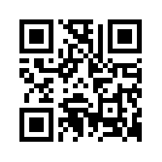
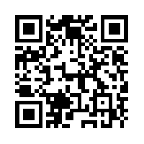
Contact Information:
Kenneth Wesson
Educational Consultant: Neuroscience
(408) 323-1498 (office)
(408) 826-9595 (cell) San Jose, CA
Ken.wesson@schoolspecialty.com
sciencemaster.com

