Slide 1
Charter Schools Leaders Meeting January 17, 2019

Slide 2
Safety Announcement
In the event of an emergency evacuation:
Please notify me if you require assistance exiting
Follow me as we vacate the room and building
Proceed to the parking lot evacuation area for roll call
Do not leave until attendance reporting is completed
We greatly appreciate your cooperation in the event of an emergency

Slide 3
Santa Clara County Office of Education
Santa Clara County Office of Education (SCCOE) is a state regional service agency that provides:
instructional, business, and technology services to the 31 school districts of Santa Clara County;
directly serves students through special education programs, alternative schools, Head Start and State Preschool programs, migrant education, and Opportunity Youth Academy through the Board of Education, authorizes county charter schools;
provides academic and fiscal oversight and monitoring to school districts and the 22 county board authorized charter schools;
provides essential services and technical assistance throughout the region and statewide.

Slide 4
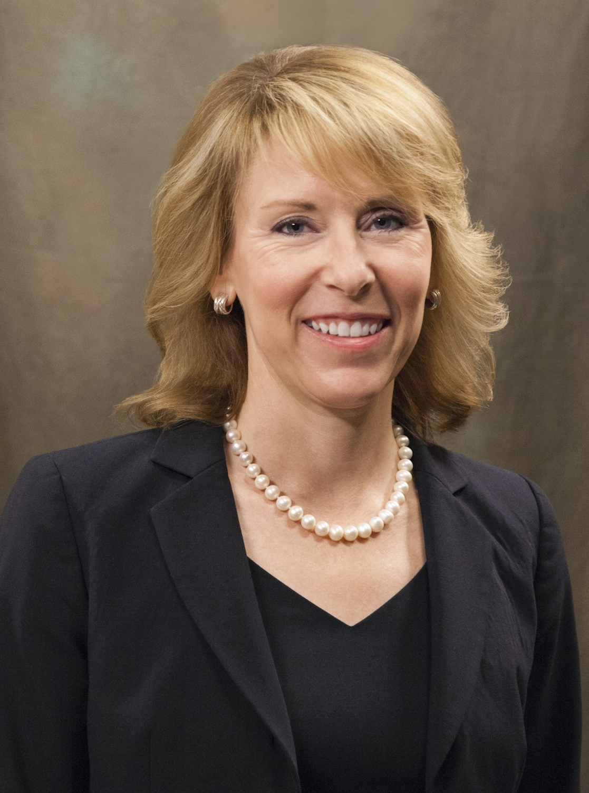
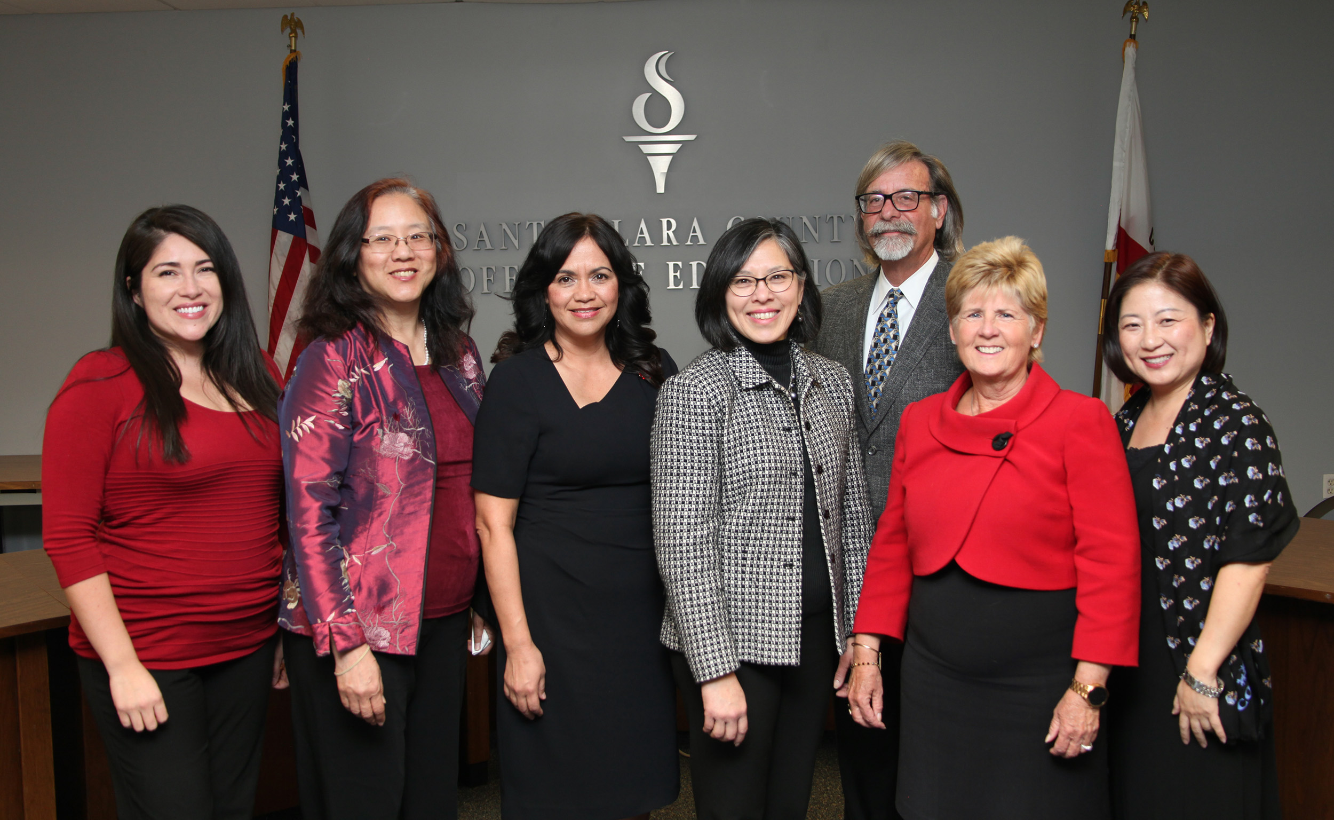
County Superintendent
County Board of Education
Dr. Mary Ann Dewan
Peter Ortiz, Area 6; Grace Mah, Area 1; Claudia Rossi, Area 7;
Rosemary Kamei, Area 3; Joseph Di Salvo, Area 4;
Kathleen King, Area 2; Anna Song, Area 5

Slide 5
Vision:
Transforming Education through Leadership, Service and Advocacy
Mission:
SCCOE is committed to serving, inspiring and promoting student and public school success
Goals:
Improve access to inclusive, equitable, high-quality education.
Provide quality support to districts, schools, students and communities.
Be a premier service organization.
Values:
Students First Service
Collaboration Strengths-Based
Innovation

Slide 6
AGENDA
ITEM | TIME | LEAD
Welcome, Introductions & Upcoming/Past Events | 12:30 | Dr. Mary Ann Dewan & Khristel Johnson
Suicide Prevention | 12:40 | Jennifer Del Bono
Science Materials Fair | 12:50 | Sandi Yellenberg & Jennifer Mutch
Myth Busters : Dispelling myths and separating the truth on charter school operations | 1:15 | Charter Schools Department
BREAK | 2:00
Myth Busters cont’d: Share out/report on myths | 2:15 | Charter Schools Department & Charter Leaders
LCAPS | 3:00 | Charter Schools Department
Recommendations / Next Steps | 3:05 | All

Slide 7
Welcome! SCCOE’s Charter Schools Department:
Khristel Johnson – Director
Karen Bennett – Administrative Assistant
Dr. Michelle Johnson – Assistant Director
Vickie Teshin-Anderson – Administrator
Christine Carbone – Financial Administrator
Shallu Sharma – Financial Administrator

Slide 8
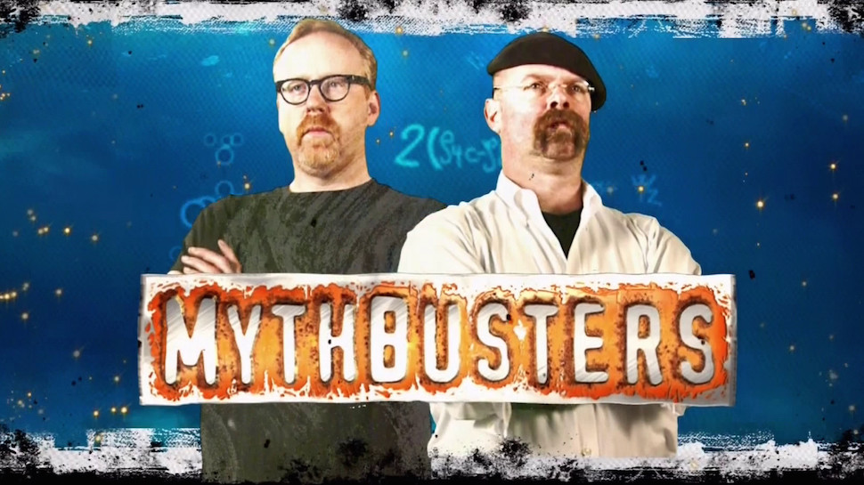

Slide 9
Jenn Mutch
Science Coordinator
Jennifer_Mutch@sccoe.org

Slide 10
Jenn Mutch
Science Coordinator
Jennifer_Mutch@sccoe.org
Sandi Yellenberg
Science Coordinator
Sandi_Yellenberg@sccoe.org

Slide 11
1st Myth to Investigate
“Science is not as important to teach to students because math and English are more important for them to succeed in the world.”

Slide 12
That’s not what the data says…
Over 50% of middle school students:
Don’t feel that the science they learn in school is related to the real world
Don’t recognize the names of many influential scientist who’s discoveries have influenced their lives

Slide 13
QUESTIONS/ISSUES

Slide 14
1st Myth to Investigate
“Science is not as important to teach to students because math and English are more important for them to succeed in the world.”

Slide 15
2nd Myth to Investigate
“As long as students get science in the upper grades, it’s alright if they don’t get access to a rigorous science program in elementary school.”

Slide 16
What Middle School and High School Science Teachers Say
Science instruction can be delayed by several years if students haven’t learned how to think like a scientist which includes:
Distinguishing between observations and inferences
Know how to measure accurately using a variety of common tools
Grasp the basic science concepts, practices and connections covered by K-5 NGSS

Slide 17
QUESTIONS/ISSUES

Slide 18
2nd Myth to Investigate
“As long as students get science in the upper grades, it’s alright if they don’t get access to a rigorous science program in elementary school.”

Slide 19
3rd Myth to Investigate
“When properly taught, science applies and builds literacy (communication), math, critical thinking and creative skills; often providing engagement that motivate otherwise reluctant learners.”

Slide 20
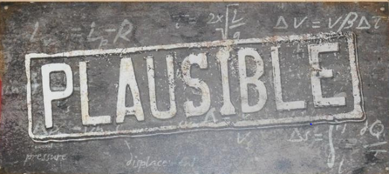
Teachers at all grade levels concur.
“When properly taught, science applies and builds literacy (communication), math, critical thinking and creative skills; often providing engagement that motivate otherwise reluctant learners.”

Slide 21
4th Myth to Investigate
“Teachers can teach Science through NGSS more effectively with NGSS created Materials.

Slide 22
4th Myth to Investigate
“Teachers can teach Science through NGSS more effectively with NGSS created Materials.
Therefore, SCCOE. is hosting a free Science Materials Fair which you are invited to attend with your science leadership educators.”

Slide 23
Tuesday, January 29 Elementary Only Wednesday, January 30 Middle & High School Only

Slide 24
How to Decide Between Instructional Material Choices
CA NGSS TIME
Toolkit for Instructional
Materials Evaluation
Train Your Science Leaders
Let us lead your process
Consider NGSS Training for teachers before selection process (You can’t select what you don’t understand fully.)
CA NGSS TIME
Toolkit for Instructional
Materials Evaluation
Train Your Science Leaders
Let us lead your process
Consider NGSS Training for teachers before selection process (You can’t select what you don’t understand fully.)

Slide 25
QUESTIONS/ISSUES

Slide 26
5th Myth to Investigate
“There isn’t much difference between the previous state science test, and the new CAST.”

Slide 27
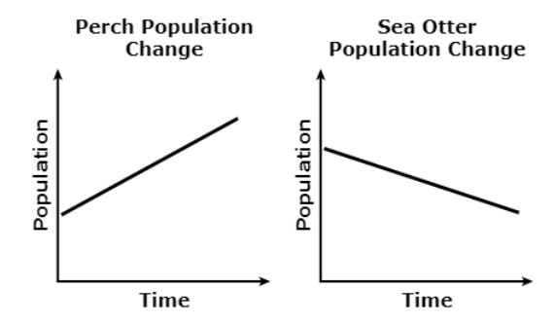
CAST 8th Grade Practice Test Questions
A student studies how populations in a kelp forest ecosystem off the coast of California are affected by changes in their food sources. The two graphs show that a change in a population of perch, a type of fish, also affects a population of sea otters.

Slide 28
CAST 8th Grade Practice Test Questions
A student studies how populations in a kelp forest ecosystem off the coast of California are affected by changes in their food sources. The two graphs show that a change in a population of perch, a type of fish, also affects a population of sea otters.

Slide 29
CAST 8th Grade Practice Test Questions
A student studies how populations in a kelp forest ecosystem off the coast of California are affected by changes in their food sources. The two graphs show that a change in a population of perch, a type of fish, also affects a population of sea otters.

Slide 30
c
A student studies how populations in a kelp forest ecosystem off the coast of California are affected by changes in their food sources. The two graphs show that a change in a population of perch, a type of fish, also affects a population of sea otters.

Slide 31
8th grade CAST-continued
The diagram shows a partial food web for the kelp forest ecosystem.
Use the graph and partial food web to predict the changes in the sea urchin and kelp populations as the perch population increases. Place the correct labels in the table shown. A label may be used more than once; not all labels may be used.

Slide 32
8th grade CAST-continued

Slide 33
8th grade CAST-continued

Slide 34
8th grade CAST-continued
The 3-dimensionality of this question:
DCI: LS2.A Interdependent Relationships in Ecosystems
SEP: Analyzing and interpreting data
CCC: Cause and effect: mechanism and explanation
MS-LS2-1. Analyze and interpret data to provide evidence for the effects of resource availability on organisms and populations of organisms in an ecosystem.

Slide 35
5th Myth to Investigate
“There isn’t much difference between the previous state science test, and the new CAST.”

Slide 36
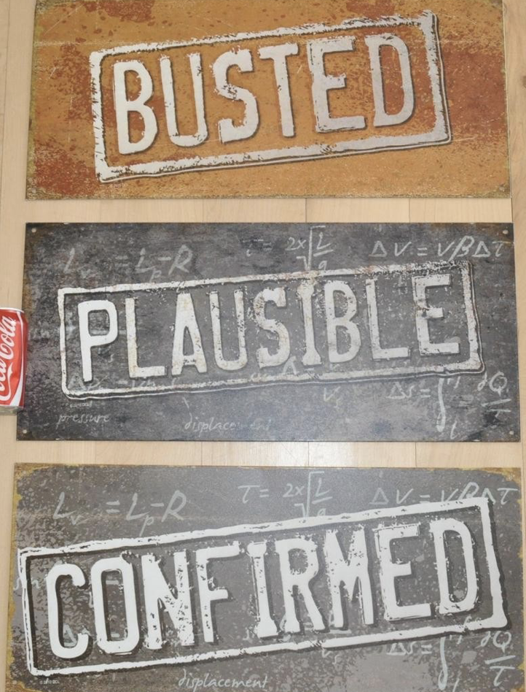
5th Myth to Investigate
“There isn’t much difference between the previous state science test, and the new CAST.”

Slide 37
QUESTIONS/ISSUES

Slide 38
NO MYTHS HERE! Training Opportunities for Educators
Science Materials Fair – Jan. 29 and 30
CA NGSS TIME - Feb. 11, 12 & 13

Slide 39
NO MYTHS HERE! Training Opportunities for Educators
Science Materials Fair – Jan. 29 and 30
CA NGSS TIME - Feb. 11, 12 & 13
Introduction to NGSS
Diving Deeper into NGSS
Teaching through Phenomenon

Slide 40
NO MYTHS HERE! Training Opportunities for Educators
Science Materials Fair – Jan. 29 and 30
CA NGSS TIME - Feb. 11, 12 & 13
Introduction to NGSS
Diving Deeper into NGSS
Teaching through Phenomenon
Contact SCCOE Science Coordinators to schedule a training date
Jennifer_Mutch@sccoe.org
Sandi_Yellenberg@sccoe.org

Slide 41
QUESTIONS/ISSUES

Slide 42
Myth Busters: Charter School Edition
Dispelling myths and separating the truth on charter school operations

Slide 43
Thinking Colors Protocol Choose a colored post-it, you will play the role represented by the color during the discussion:
Neutrality (grey): Asks Questions. Given the available information, what are the facts?
Feeling (orange): Responsible for instinctive gut reactions or statements of emotional feeling (but not any justification).
Negative judgment (purple): Seeks mismatches in the discussion by applying logic and identifying flaws or barriers.
Positive Judgment (yellow): Seeks harmony in the discussion by using logic to identify benefits.
Creative thinking (teal): Keeps the conversation going through statements of provocation and investigation.
The Big Picture (blue): Often used by the discussion facilitator, who sets the objectives, keeps the group on task, and sets new objectives.

Slide 44
Example:
MYTH: Charter schools can mandate that parents volunteer time and/or commit funds to the school
Evidence to dispel this:
Handbook, Policies, Website, Welcome Letters, Parent Groups, Reference to Law, Petition Language

Slide 45
Myth #1
Charter schools are private schools with public funds

Slide 46
Myth #2
Once a charter school opens, that school remains open as long as it has enough money to survive

Slide 47
Myth #3
Students are counseled out of charter schools

Slide 48
Myth #4
Teachers at charter schools do not need credentials

Slide 49
Myth #5
There are no formal procedures for parent complaints at a charter school

Slide 50
Myth #6
The SCCOE’s Charter Schools Department determines which charter schools are approved, denied, or revoked

Slide 51
Myth #7
Charter schools do not have to comply with the Brown Act

Slide 52
Myth #8
Charter schools are selective of their students as opposed to granting admission to all students

Slide 53
Myth #9
Special Education students are not provided with the full continuum of services in charter schools

Slide 54
Myth #10
Adequate school housing/facilities and maintenance do not apply to charter schools

Slide 55
Myth #11
Charter schools do not have any formal processes (finances, SARB, complaints, etc.)

Slide 56
Myth #12
Monthly fiscal reports are simply “busy work” for the charter school and are not reviewed

Slide 57
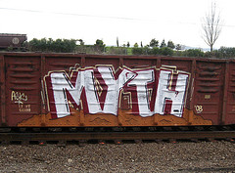
Myth #13
Under Prop 39, it is the responsibility of the school district to provide all the facilities and provide the upkeep thereof

Slide 58
Myth #14
SCCOE can/should/may/etc. “fix” any problem without stepping on the autonomy of the charter school

Slide 59
Myth #15
LCAPs are not required for charter schools

Slide 60
Myth #16
Charter schools are driven by financial gains rather than helping students

Slide 61
BREAK

Slide 62
Recommendations / Next Steps
Notes:
Summary of topics addressed @ June 5, 2018 Charter Leaders Meeting
Definition of support
Honor autonomy
Responsibilities as Authorizers
Communication
Internal/External Concerns
Network Leaders
Charter Authorizers of SCC
Web Page
Protocols/Procedures
Annual visits
Student files
Petition/Renewals
Resources
LCAP – Ongoing trainings
Training when available from other departments

Slide 63
Closing
Next Charter Leaders meeting –
Thursday 5/2
Remember to check the website
Your feedback is valued!

