Slide 1
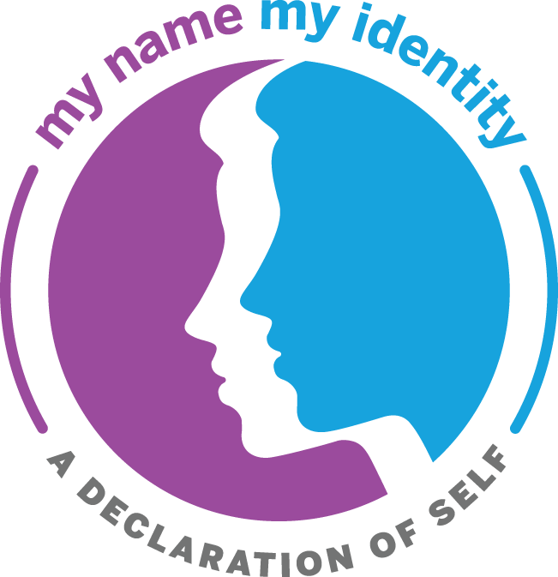
My Name, My Identity:
Creating Community Challenge
Building an Inclusive and Respectful School Community

Slide 2
My Name, My Identity
Initiative
The My Name, My Identity initiative is a partnership between the Santa Clara County Office of Education (SCCOE) and the National Association for Bilingual Education (NABE). It is intended to help create a culture of respect and inclusiveness in school communities across the nation by asking students, educators, parents, and community members to take the pledge to pronounce student names correctly and to honor their identities.
The impact of this affirming practice has been felt worldwide, and has positively contributed to realizing a sense of community, growth, and learning both inside and outside the classroom.

Slide 3
Welcome Back! 2022-23 School Year
A great way to welcome back students to the new academic year is creating a welcoming school that builds on positive relationships, a sense of belonging, a culture of respect, and values of diversity.
The SCCOE created the My Name, My Identity: Creating Community Challenge with the intent to promote and celebrate equitable and innovative practices. Santa Clara County schools and classrooms that submit artifacts responding to the three themes: Welcoming School, Building Community, and Celebrating Diversity by January 12, 2023 will be recognized at the Santa Clara County Bilingual/Multilingual Learner Advocacy Month Showcase on April 27, 2023. Schools and districts that are outside of Santa Clara County are also welcome to submit artifacts. Selected artifacts will be posted on the My Name, My Identity website.

Slide 4
My Name, My Identity:
Creating Community Challenge
Building an Inclusive and Respectful School Community
What: Build an inclusive and respectful school community
Why: Create a welcoming school that builds on positive relationships, a sense of belonging, a culture of respect, and values of diversity
How: Participate in the Community Challenge by completing one project for each of these three themes: Welcoming School, Building Community, and Celebrating Diversity using the resources on this slide deck

Slide 5
Be Recognized
The My Name, My Identity Initiative is an illustrative example of the English Learner Roadmap Principle One: Assets-Based and Needs Oriented Schools.
Schools and classes in Santa Clara County submitting one artifact from each of the three themes by January 12, 2023 will be recognized at the Santa Clara County Bilingual/Multilingual Learner Advocacy Month Showcase on April 27, 2023.
Artifacts can include a video (limit to two minutes), a drawing, a collage, a poster, an essay, or a podcast (limit to two minutes).
Rubric for each theme can be used to guide the creation and completion of each project.

Slide 6
My Name, My Identity: Creating Community Challenge Themes
1. Welcoming
School
2. Building
Community
3. Celebrating
Diversity
Relationship & Engagement
Belonging, Inclusion & Respect
Diversity & Innovation
Helping everyone feel welcomed by pronouncing others’ names correctly
Helping everyone feel seen, heard and that they belong in school
Helping everyone feel proud of who he/she/they are
Creating a safe and welcoming school environment
Building a culture of respect and inclusiveness
Affirming and celebrating diversity creatively

Slide 7
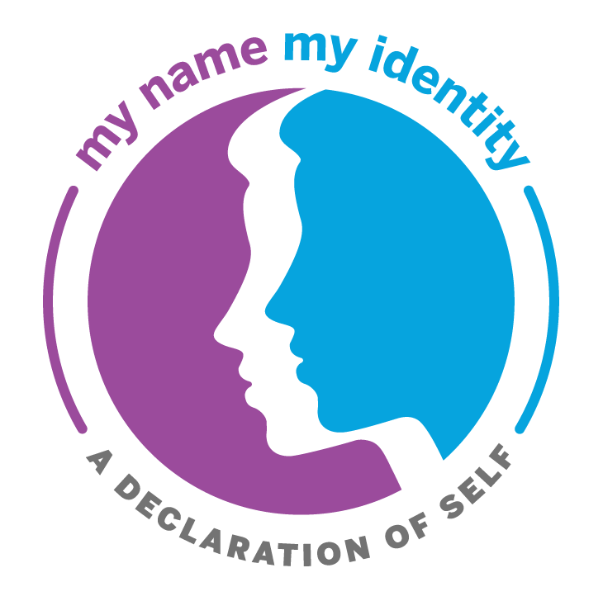
Welcoming School
Relationship & Engagement
Driving Question
What makes you and your family feel safe and welcomed in your school or class?
Choice Board of Project Ideas Complete at least one project as a school or class
Encourage students to create a physical or virtual space in their classroom or school that showcases ALL community members’ names & identities. Share student samples. | Choose Your Own Adventure Try a new or existing project that you are excited about in your school or classroom. Share an artifact from your project. | Create and swap name story stickers. Share student samples.
Create a pledge that helps students feel they belong and are respected. Share student samples. | Invite students to share their name stories as “Name of the Day” during morning announcements. Share student written or recorded samples. | Design a paper or digital name badge that students will present to peers or family. Share student samples.
Learning Resources
My Name, My Identity: Creating an Inclusive and Respectful School Community Educator Toolkit
Family Interview Activity
Digital Name Badge Project
Resources for Gender and LGTBQ+ Inclusive Schools

Slide 8
Building Community
Belonging, Inclusion & Respect
Driving Question
What makes you and your family feel you belong and are respected in your school or class?
Choice Board of Project Ideas Complete at least one project as a school or class
Share your name story with a classmate or peer so that they know your name and/or identity story and is able to share it with others. Share an artifact of the project. | Investigate the rich history in your community using the Community Identity Map and build a map highlighting your findings. Or, visit places in your neighborhood and share what students discovered. | Create a Community/Class Agreement to cultivate respect and build community. Share your agreement.
Choose Your Own Adventure Try a new or existing projects that you are excited about in your school or classroom. Share an artifact from your project. | Set up an opportunity for students to meet, mingle and share their names and name stories with new friends during lunch or breaks. Have students wear a name tag. Share an artifact. | Create a school-wide My Name, My Identity “Building Community” Art Contest. Share student samples.
Learning Resources
Beyond the Bake Sale Parent Engagement Resources
Edutopia - Building Community in the Classroom
Facing History and Ourselves - Back to School: Building Community for Connection and Learning
Edutopia: Every Student Matters

Slide 9
Celebrating Diversity
Diversity & Innovation
Driving Question
What makes you and your family feel your differences are valued and celebrated?
Choice Board of Project Ideas Complete at least one project as a school or class
Create a collage that shows the strengths in your school, classroom, or community. Share your collage. | Create a paper chain/web that celebrates identity as we are all diverse and linked. Students design a personalized link to share their identity (how they see themselves) with their classroom/school. | Choose Your Own Adventure Try a new or existing project that you are excited about in your school or classroom. Share an artifact from your project.
Share an artifact that highlights diverse, influential individuals in a selected content area Ex: Scientist Spotlight, Modern Mathematicians, or Authors from Around the World. | Host a night, week, or month of community celebrations with student and family events at various times of the day and share an artifact. | Expand upon established celebrations, days and months, to highlight diversity in the community that dismantle stereotypes. Share an artifact.
Learning Resources
Monthly Celebrations
Books Featuring Diversity Book List on Diversity & Inclusion, K-5
Teaching Strategies | Facing History and Ourselves
Multicultural Educator vs. Anti-Racism Facilitator
Celebrations can be year-round.

Slide 10
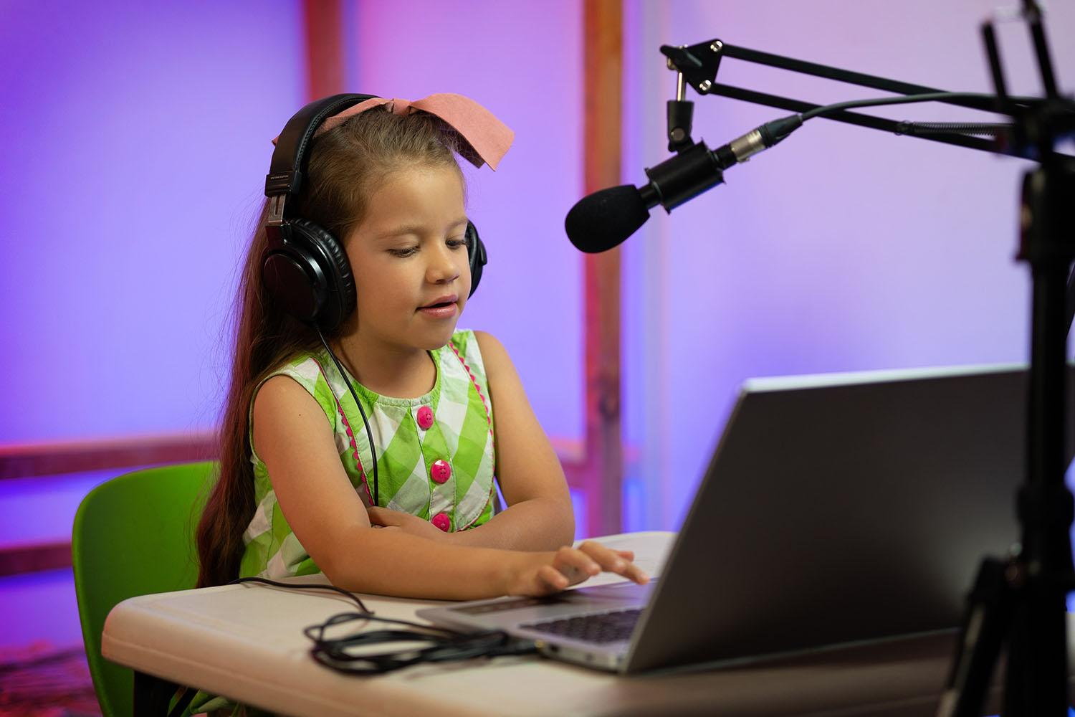
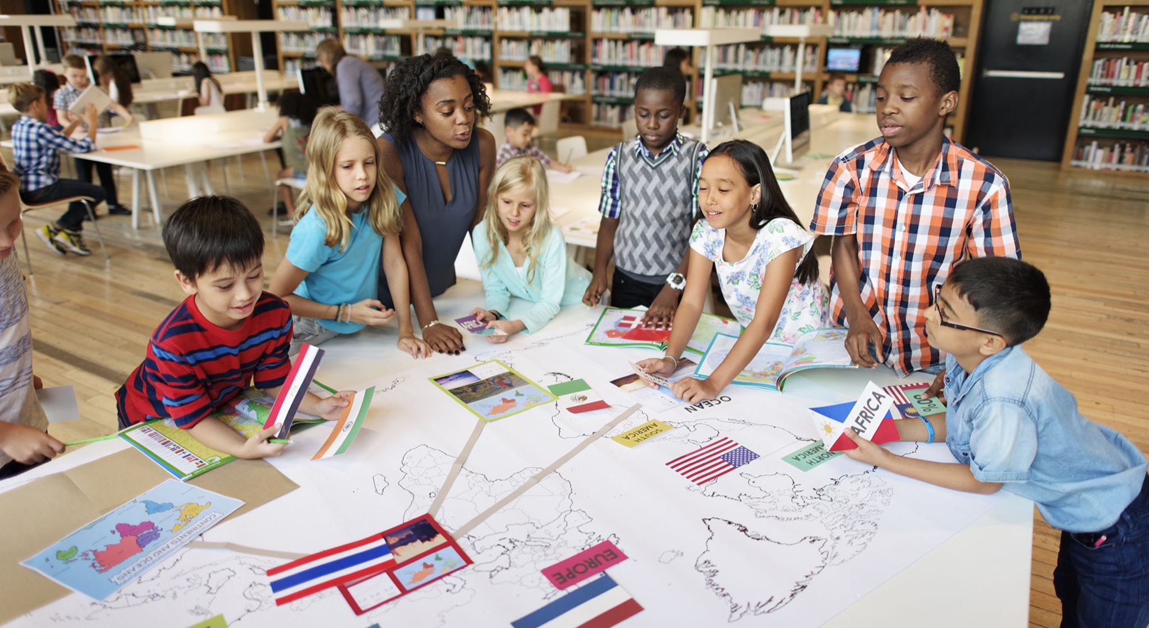
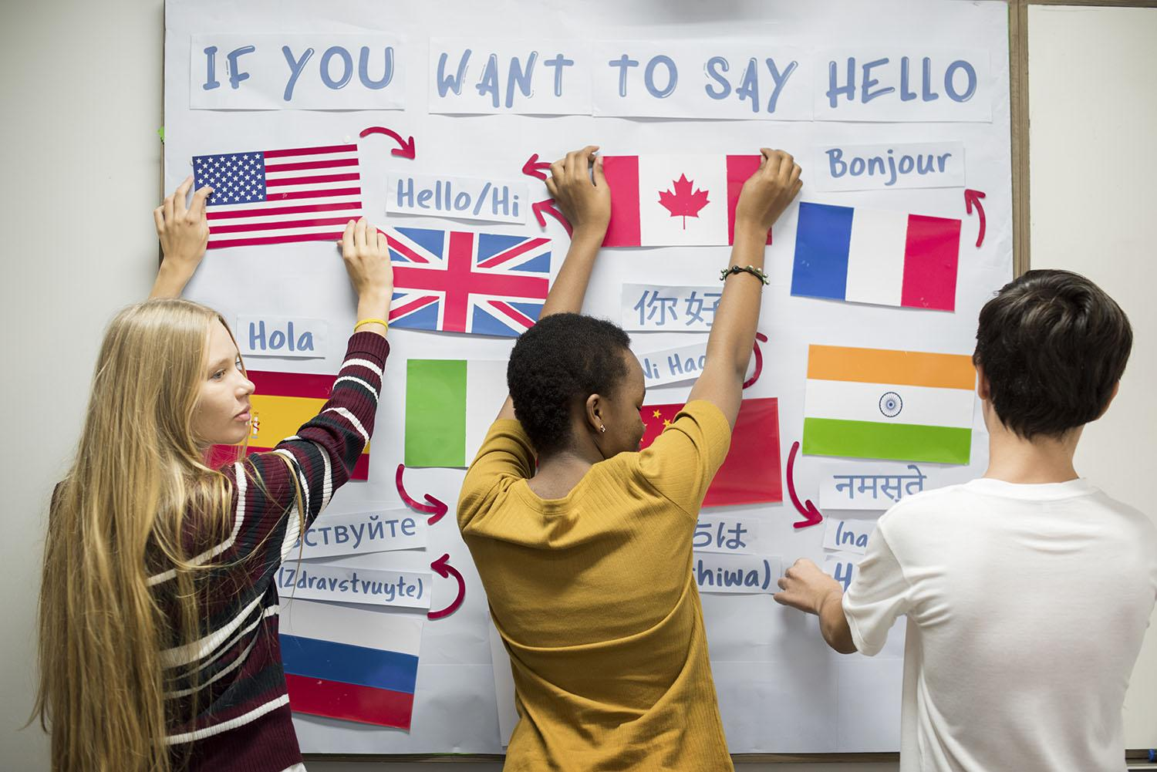
Submit Your Artifacts
by January 12, 2023
Prior to submitting your student/group/class/school artifact(s), please review and complete the Single Point Rubric for each submission.
Artifact and rubric for each theme should be submitted on a separate Submission Form.

Slide 11
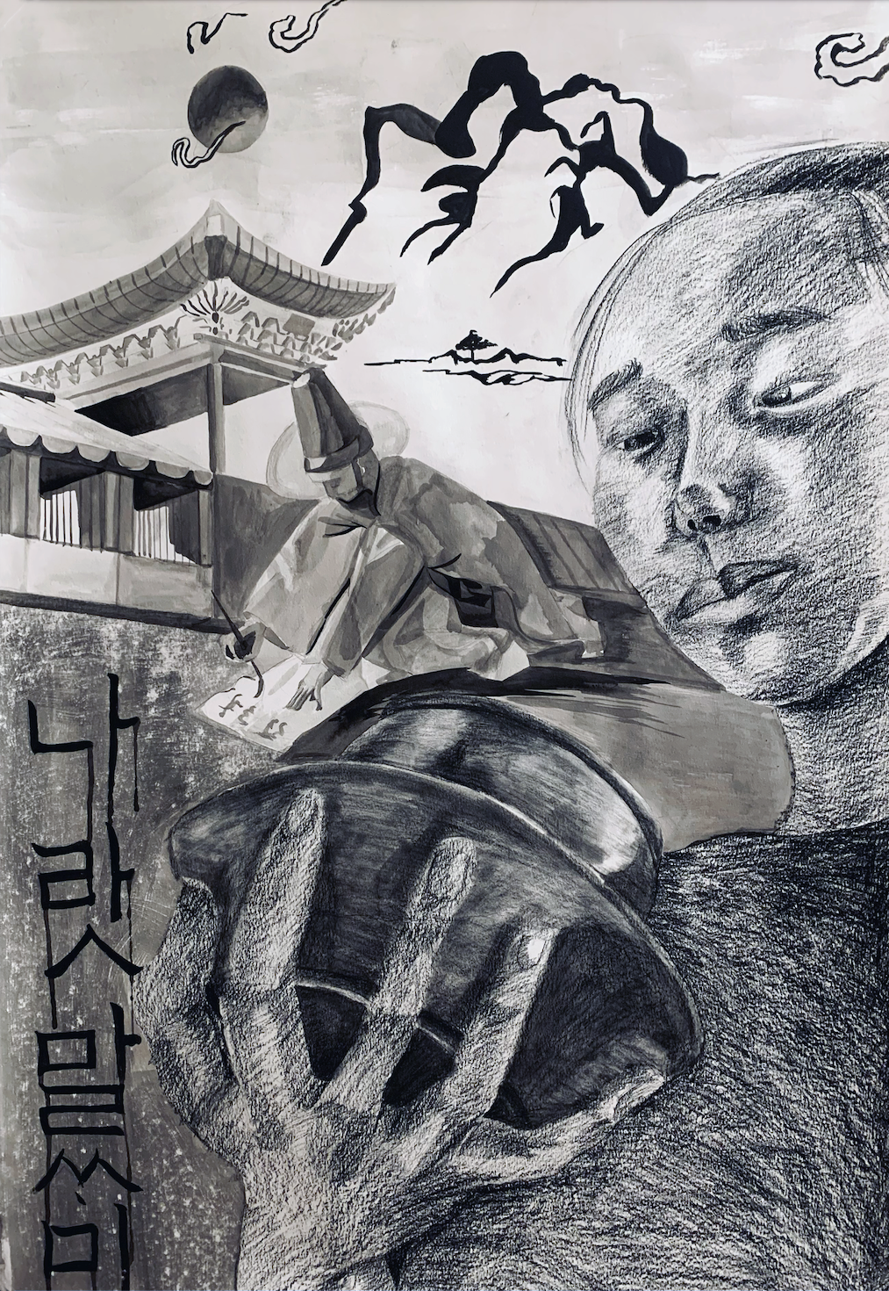
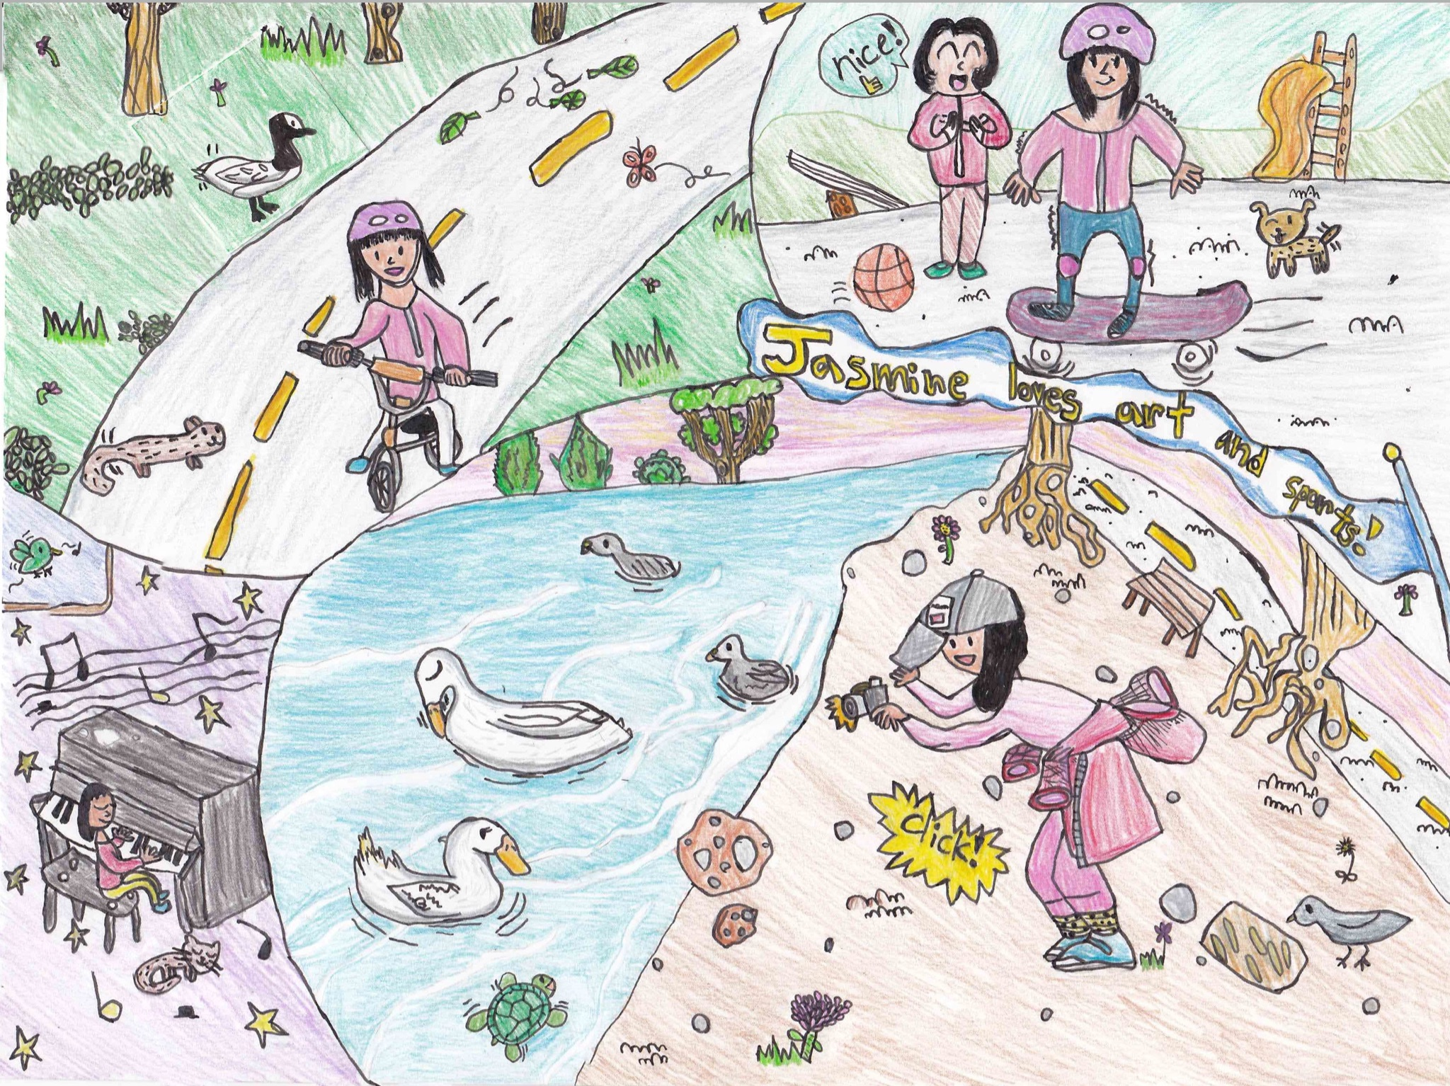
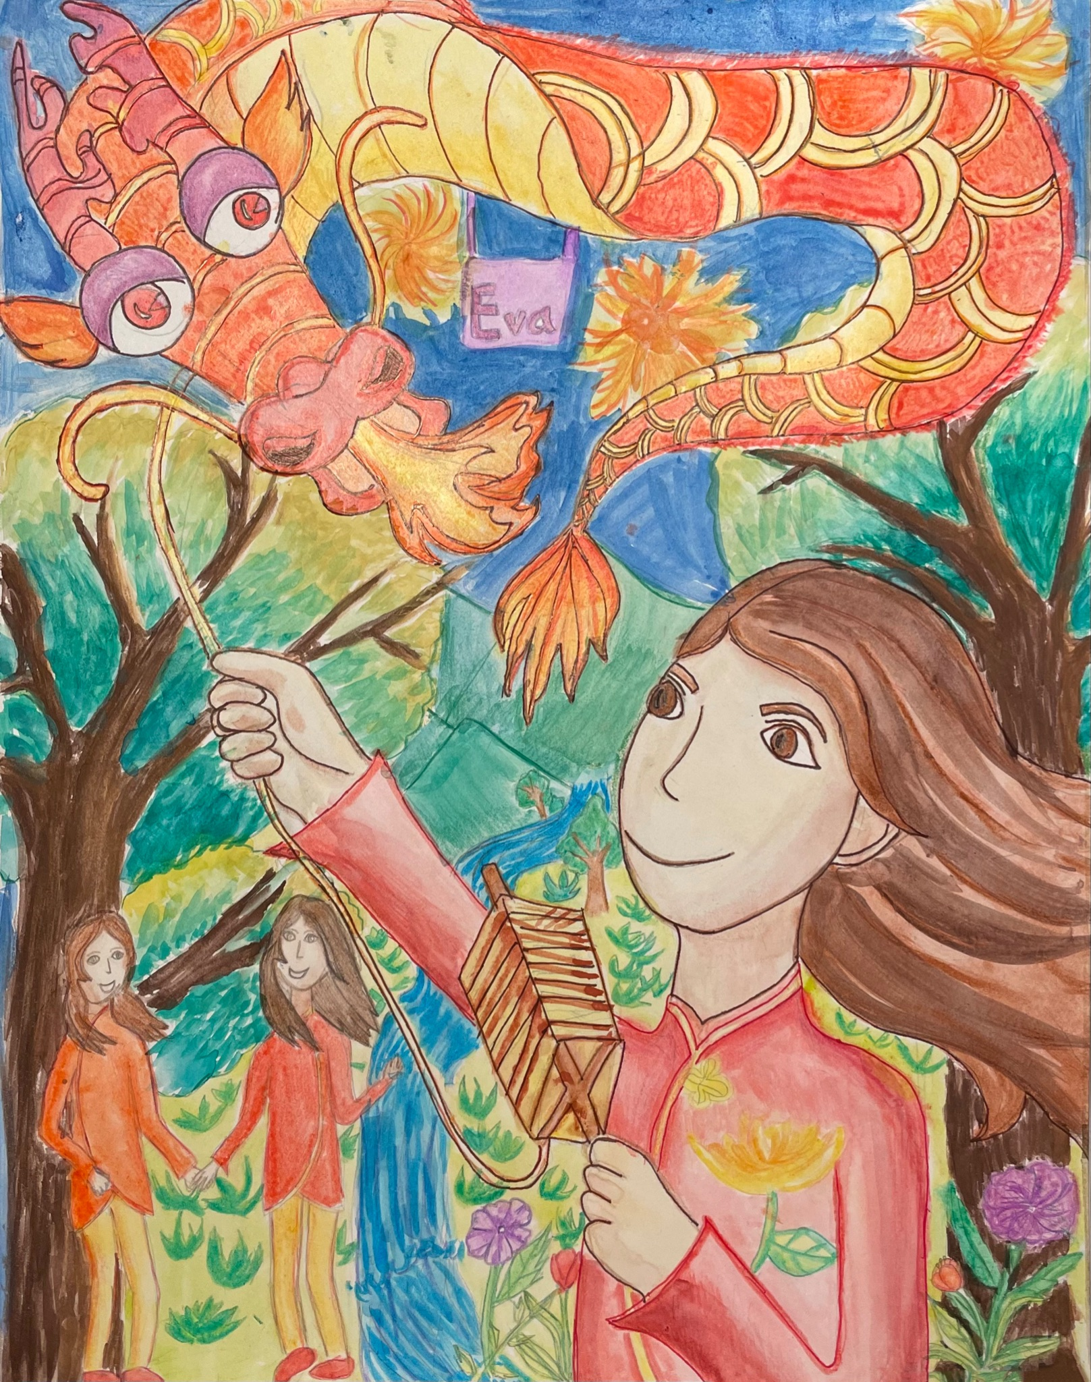
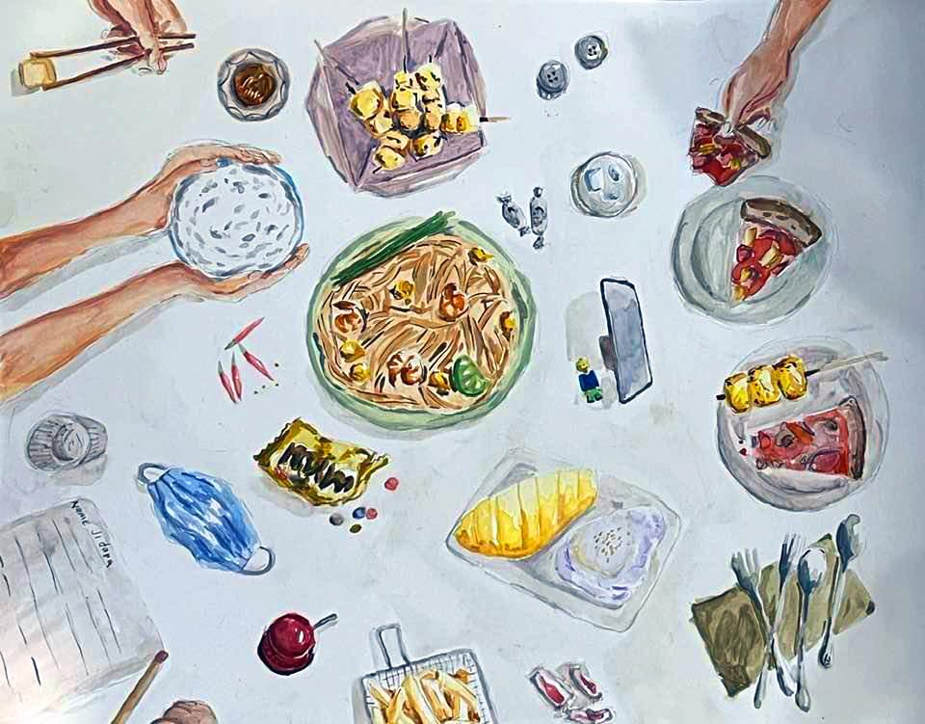
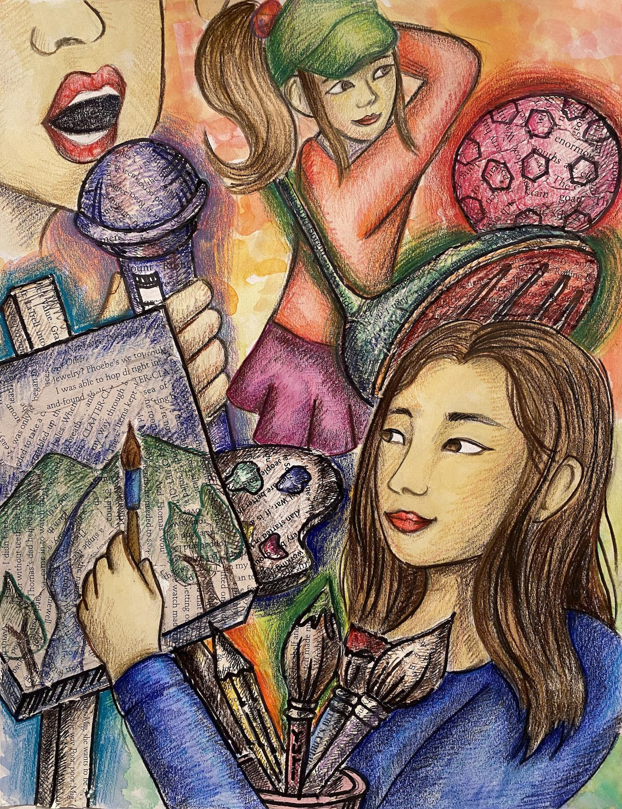
Submissions for the
My Name, My Identity Student Art Contest
due by March 2, 2023
“My Name, My Identity: Celebrating Diversity” Submission Form
For more information about the annual art contest, please visit the
My Name, My Identity Student Art Contest webpage.

Slide 12
Acknowledgments
Mary Ann Dewan, Ph.D., County Superintendent of Schools, Santa Clara County Office of Education
Anisha Munshi, Ed.D., Associate Superintendent, Professional Learning and Instructional Support Division, Santa Clara County Office of Education
Co-leads, Santa Clara County Office of Education
Yee Wan, Ed.D., Director, School Climate, Leadership and Instructional Services
Karen Larson, Director, Integrated STEAM
Sandya Lopez, Director, Inclusion Collaborative
Content Contributors and Advisors
Kasturi Basu, Alum Rock Union School District
Hong Nguyen, Ed.D., San Ramon Unified School District
Keysha Doutherd, Sofia Fojas, Jaime Koo, Christa Norum, Tara Sikorski, Gena Pacada, Santa Clara County Office of Education
Denise Williams, Silicon Valley Education Foundation
Advisors
Denise Giacomini, Educator
Efraín Tovar, Selma Unified School District
Natalie Andrade, Olivia Santillan, Santa Clara County Office of Education
Sofia Sorensen, Santa Cruz County Office of Education
Graphic Designers
Michael Kanemura, Tara Sikorski, Santa Clara County Office of Education
Copy Editors
Jasmine Leyva, Payje Redmond, Santa Clara County Office of Education

