Slide 1
The Fentanyl Epidemic in Schools

Slide 2
Learning Outcomes
Recognize and appreciate the scope of the fentanyl epidemic as a newer trend in the larger scope of the opiate epidemic.
Encourage discussions, workshops and education about Fentanyl use, overdoses and treatment in schools.
Learn to recognize the factors such as mental health issues, social inequity, domestic stressors, and involve families and communities in making available resources and help to combat these issues.
Recognize the role of social media and the illegal drug market online accessible to children and adolescents.
Discuss the role of Narcan and its use and storage in schools.

Slide 4
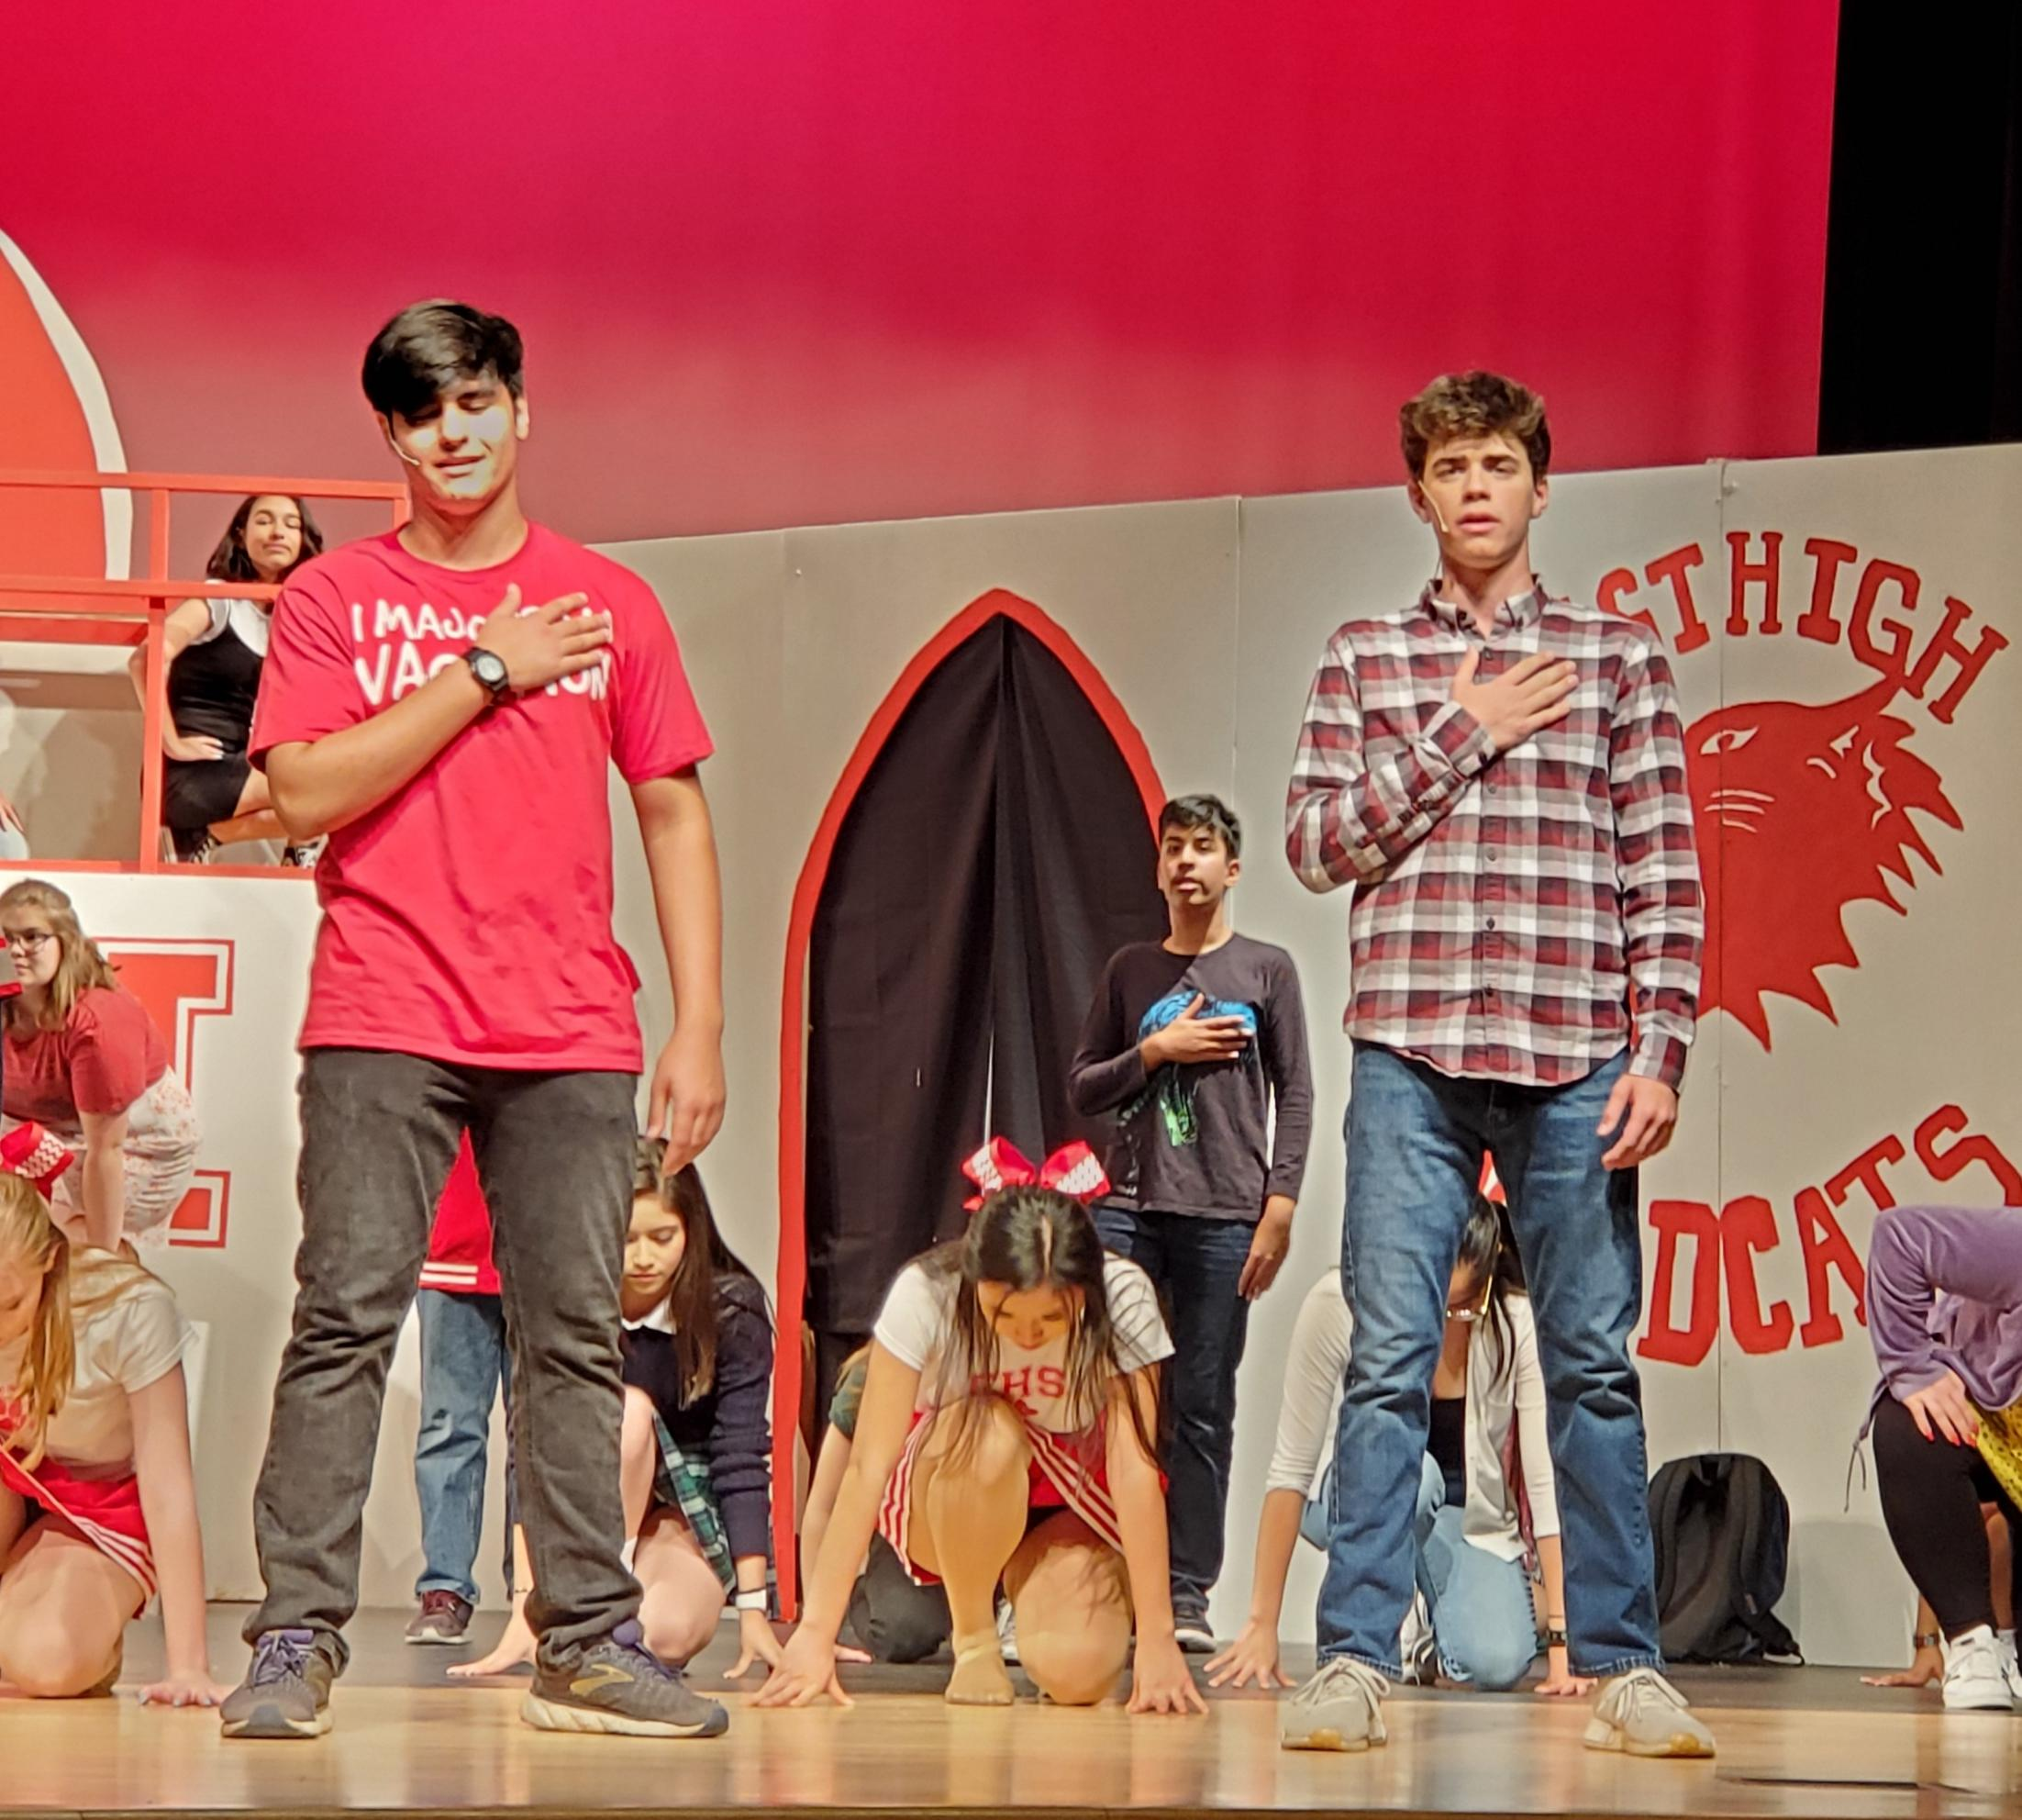
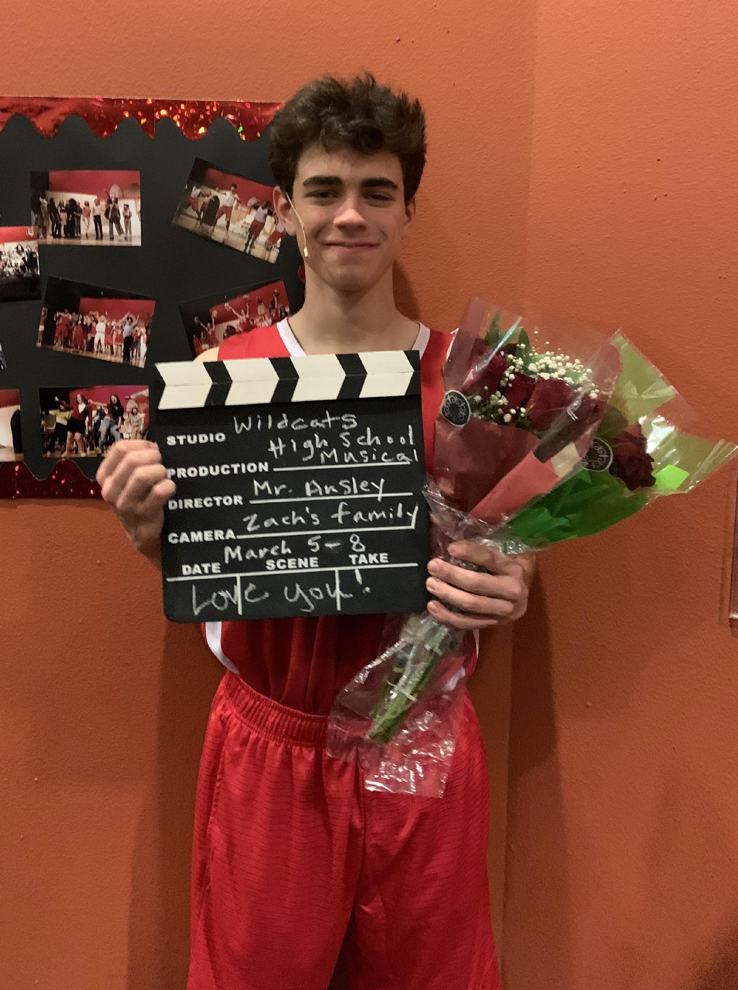
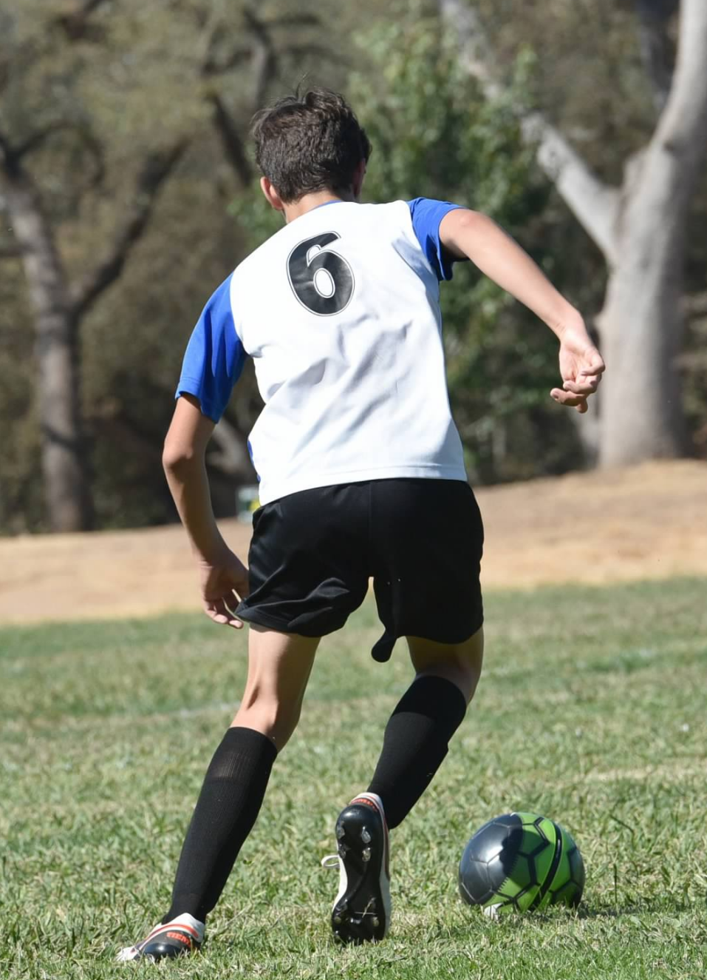
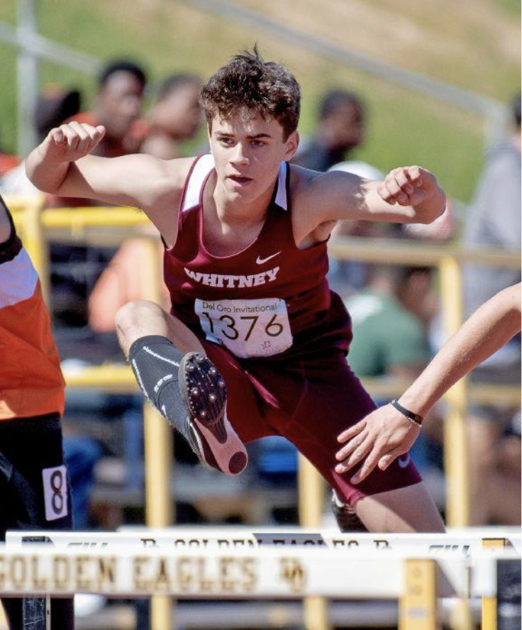
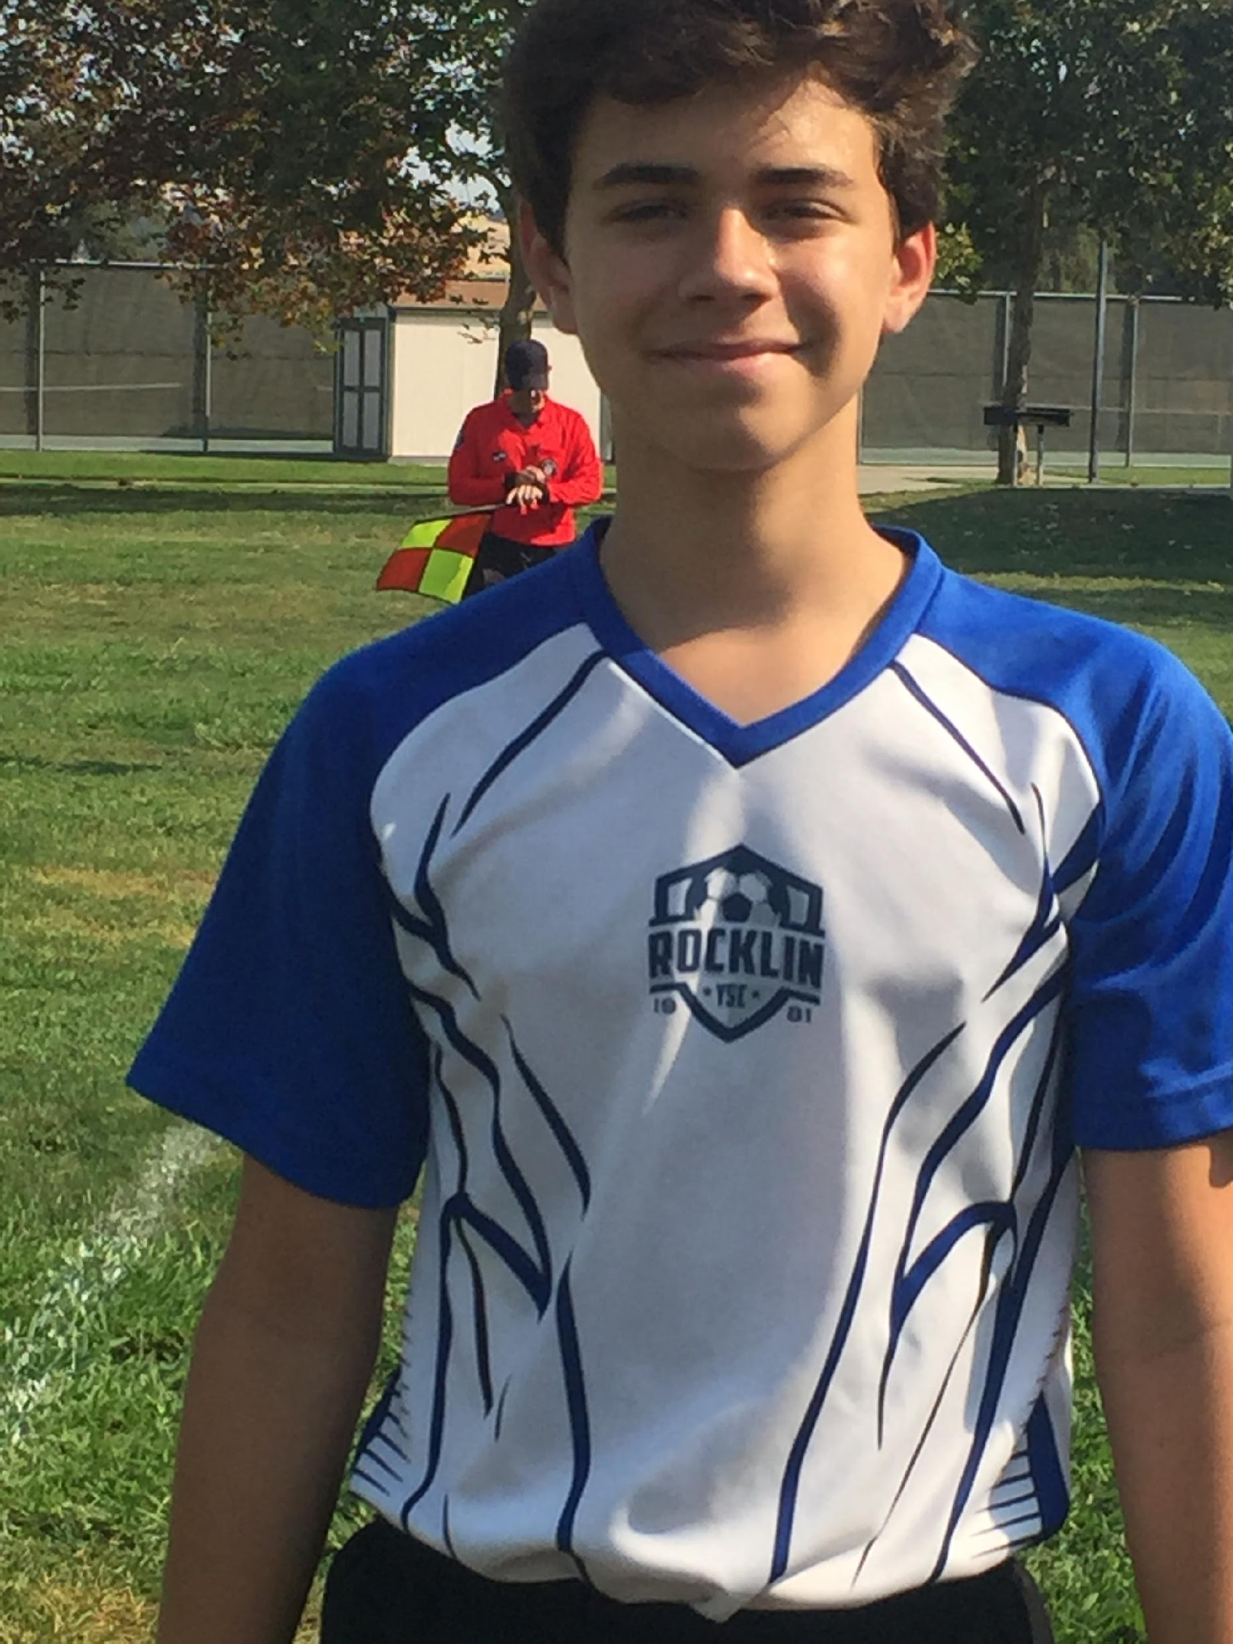
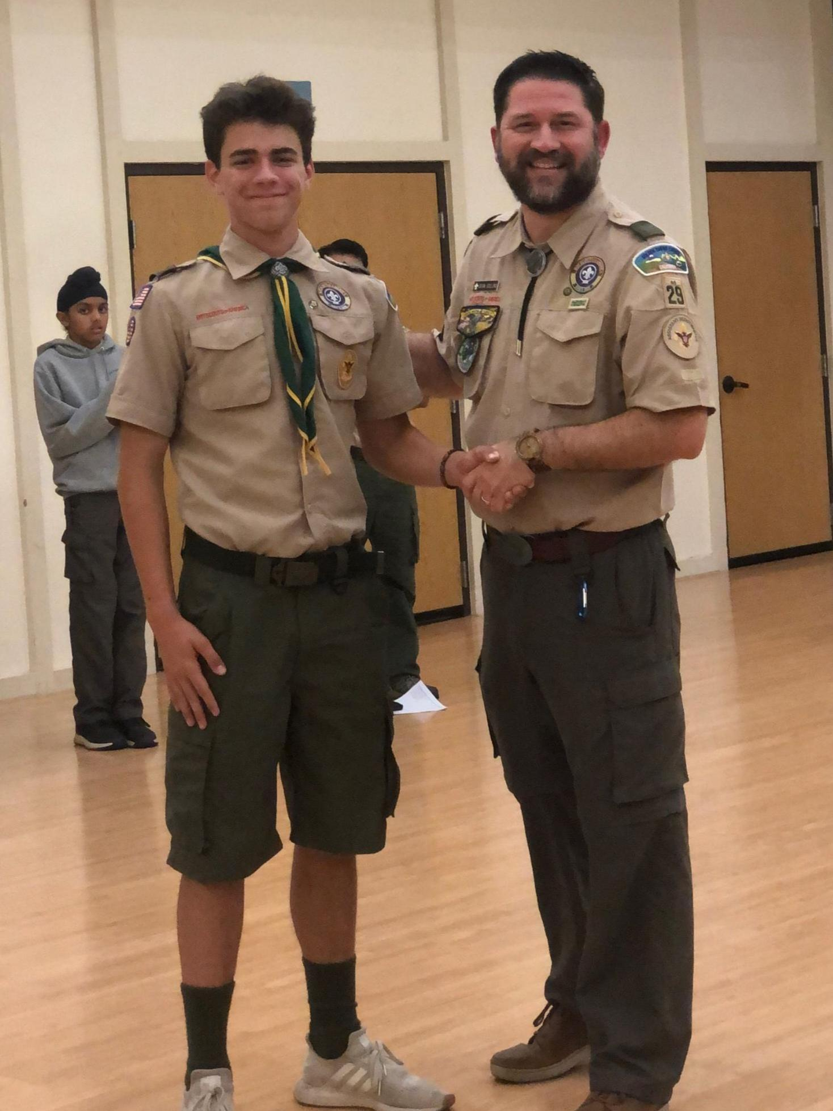
Who is Zach?

Slide 5
What Happened to Zachary?
Zach bought a Percocet via social media
But the pill was a counterfeit made of fentanyl; aka: ‘fentapill’
Zach died shortly after in his room. He never had a chance.
TOXICOLOGY RESULTS: Fentanyl intoxication. (No Percocet)
Not a party death. Not an overdose. Not an addiction casualty

Slide 6
The New Category of Victim
Healthy choices lead to a healthy life path.
Occasional Recreational User
Unhealthy choices can lead down a dangerous path
Initial Experimental User
Opportunities for Cessation
Moderation
Age out of risky behavior
Intervention
“One Pill Can Kill”
Habitual User
Dependent User
(Fastest Growing Victim Group)
Younger
Inexperienced
Naïve/Trusting
Low Body Tolerance
Accidental Overdose

Slide 7
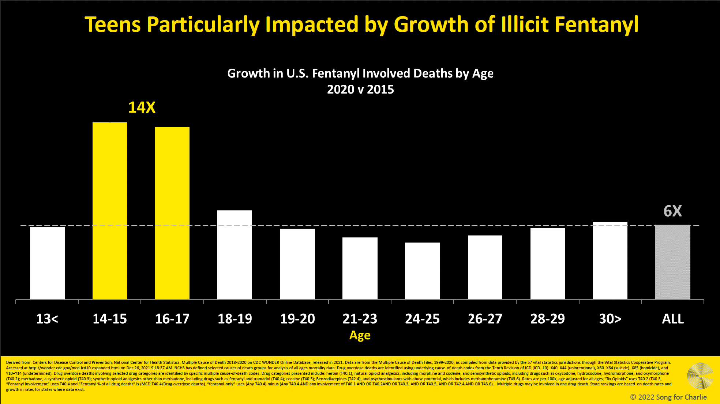
Growth in U.S. Fentanyl Involved Deaths by Age
2015 vs 2020
WHY??
>2x
greater
6x
(Avg)
Notes:
Introduction of fentanyl into the drug supply has caused an increase death rates.
Experimenting 14-17 year olds impacted the most… likely due to pills (this age group generally hasn’t progressed to harder drugs)

Slide 8
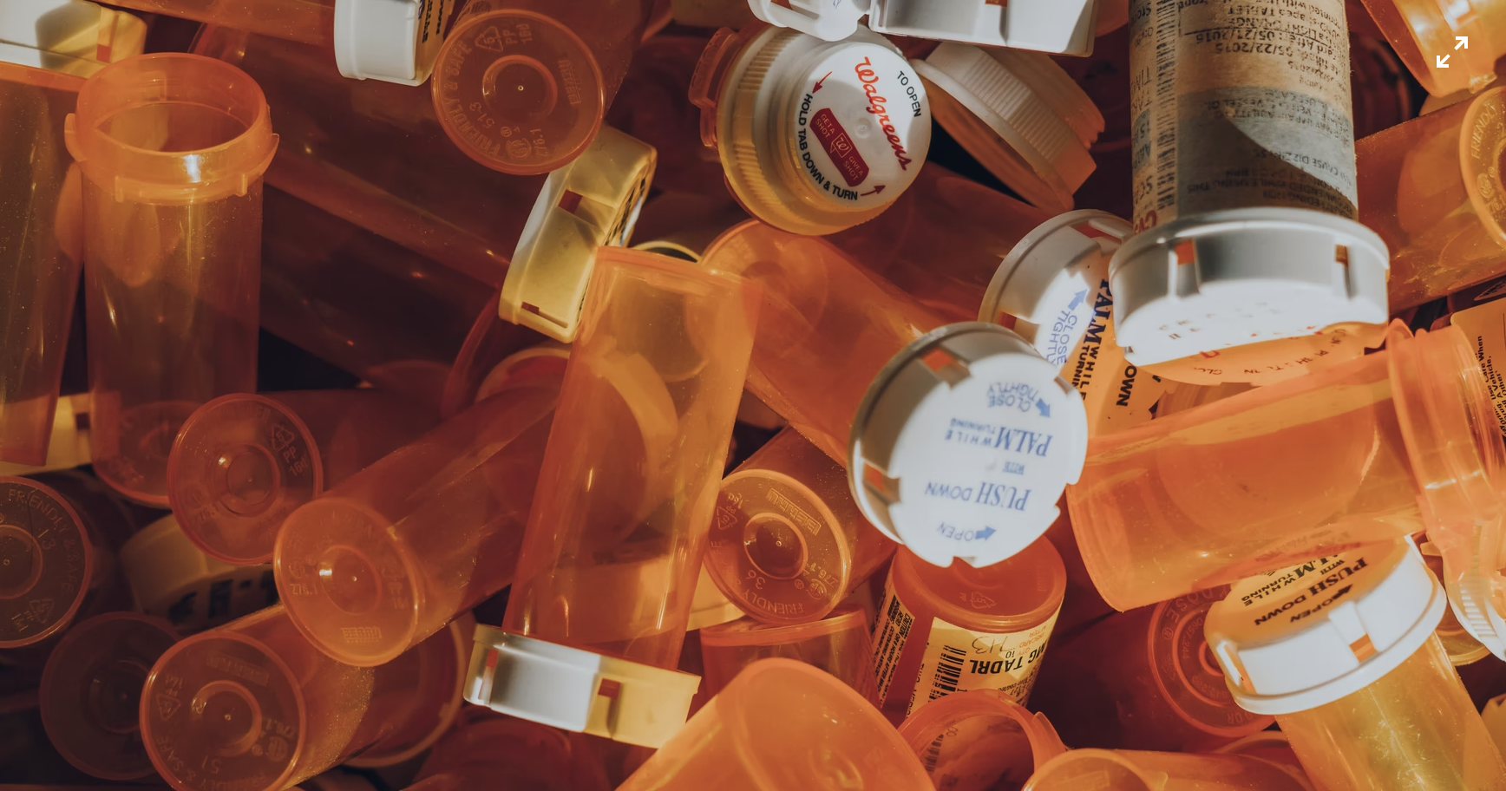
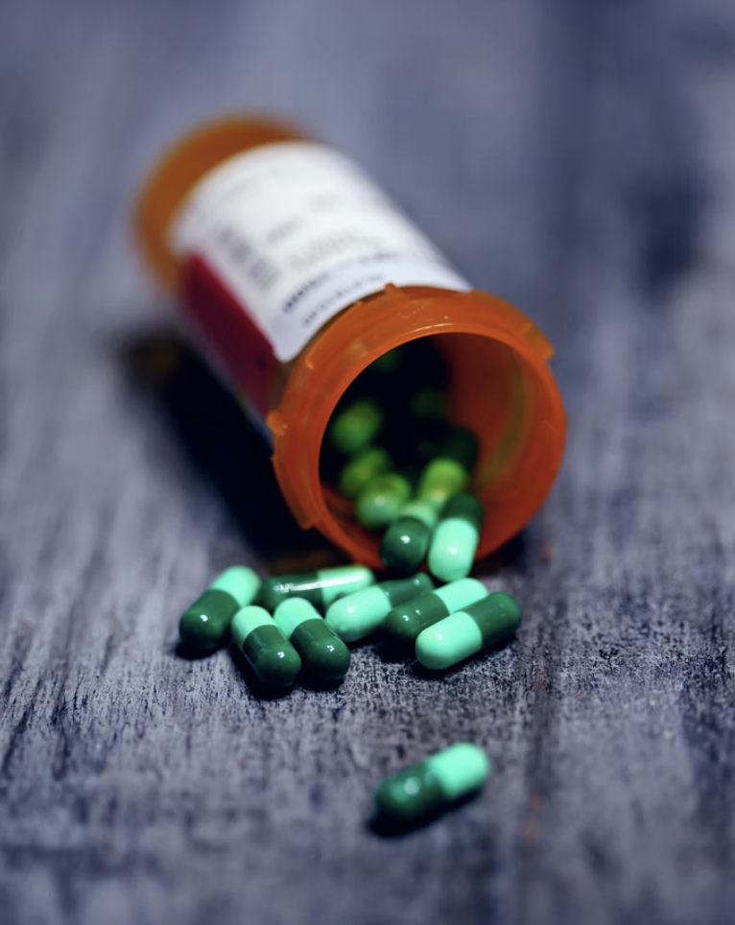
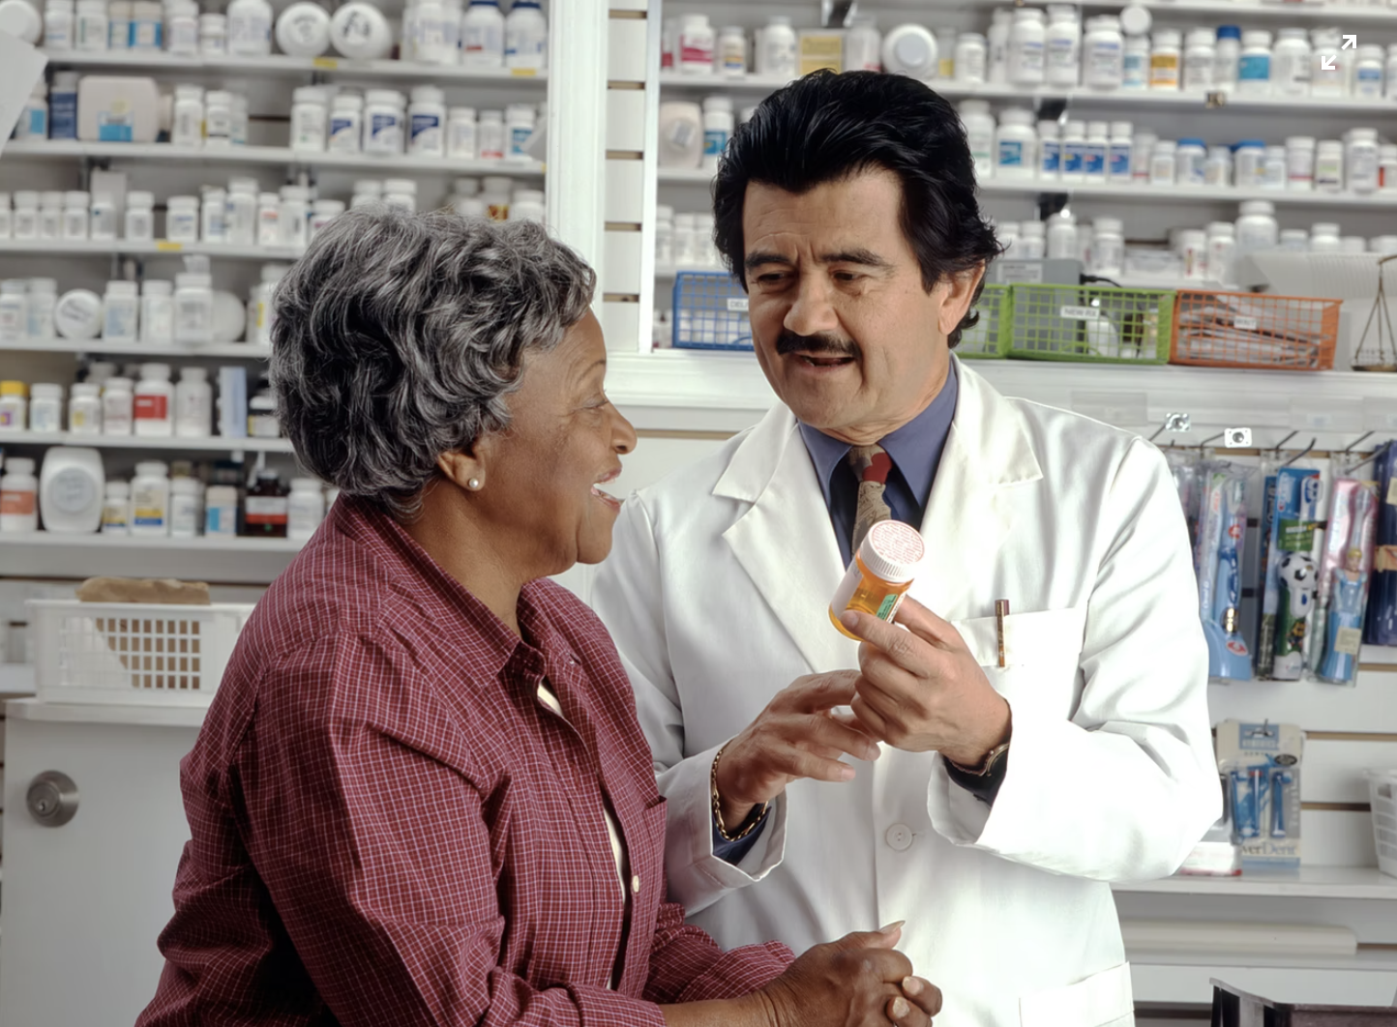
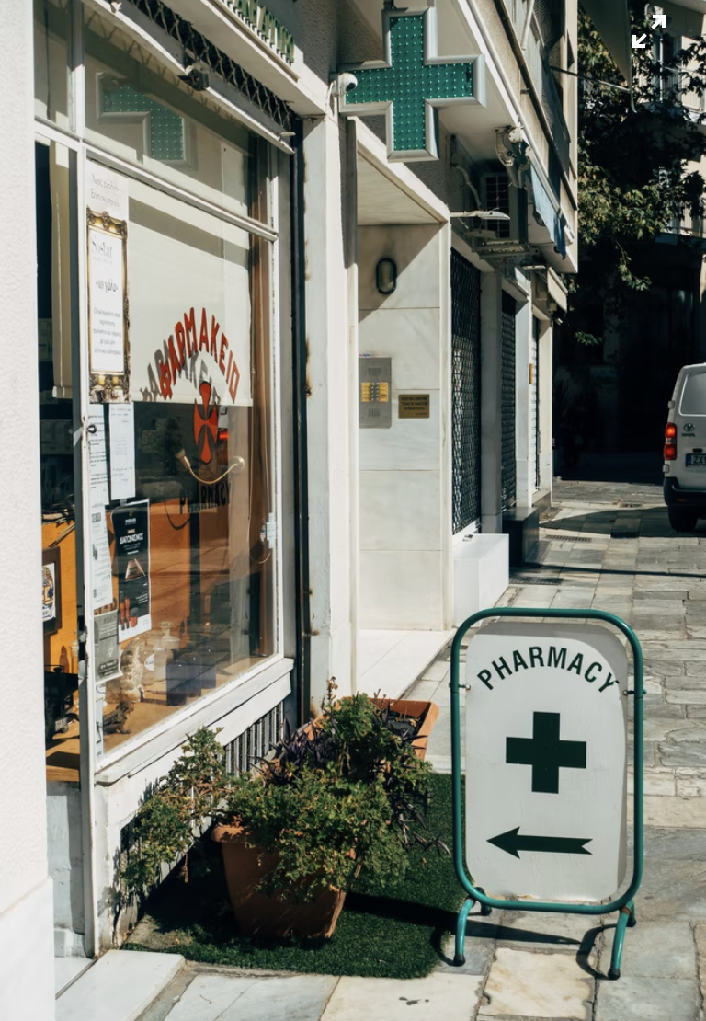
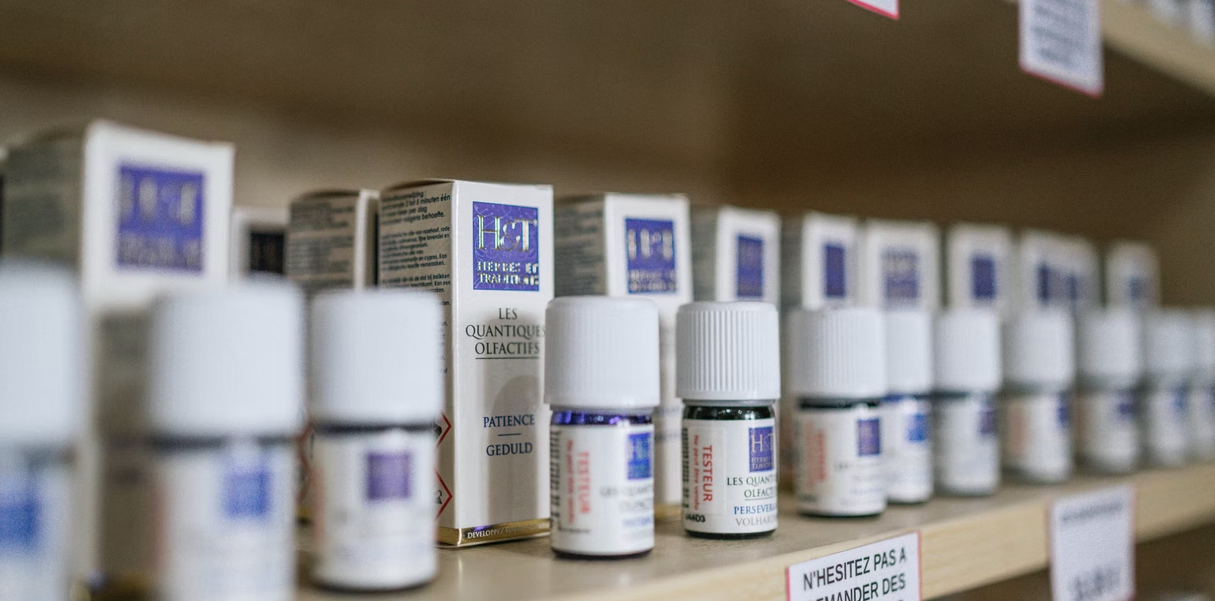
2 INFLUENCERS:
2. Legitimate Prescription Pills:
-Many teens prescribed to them
-Siblings, family and friends too
-Pills are more Normalized
1. Cellphones:
-Many teens have them
-Become reliable & trusted resource
-Very popular
1. Legit Prescriptions give appearance of a “safe” product
+
2. Cellphones give appearance of a “trusted” solution
=
Potential for deception and unperceived Danger
Notes:
1. Cellphones are very common.
-I didn’t have one in HS (they do)
-much of our teens lives.
-solve math homework problems
-climb the ladder of social acceptance
-learn to play an instrument on their own
-become a reliable and trusted resource
Drug traffickers and dealers know this
Exploiting through Social medial like never before
Social media is a Super Highway for illicit drug transactions
Entire kill chain in on the cell phone today
2. Legitimate prescriptions pills:
-much more common today than when I/we were their age
-Many teens today have been prescribed legitimate prescription from their Dr.
-To help w/anxiety to treat for ADHD
-To help manage pain when extracting teeth to prepare for braces
-See Their siblings, cousins, friends with a legitimate prescription
-Prescription pills are more normalized.
Understanding legitimate pills from a Doc/Pharmacy gives the appearance of something safe. But in reality, fake pills are often the most dangerous products. And combined with accessibility through social media, a real potential for danger exists.

Slide 9
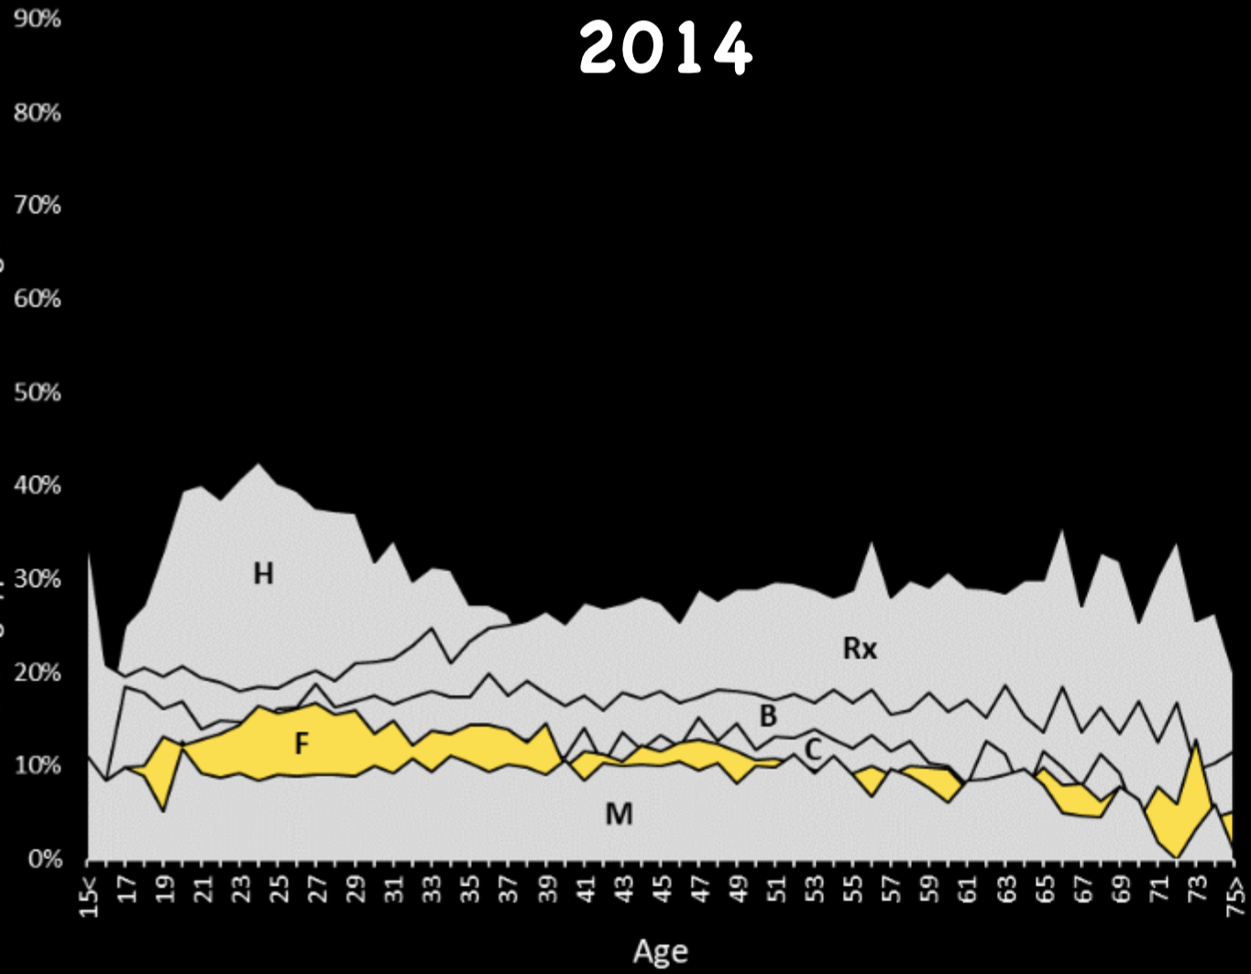
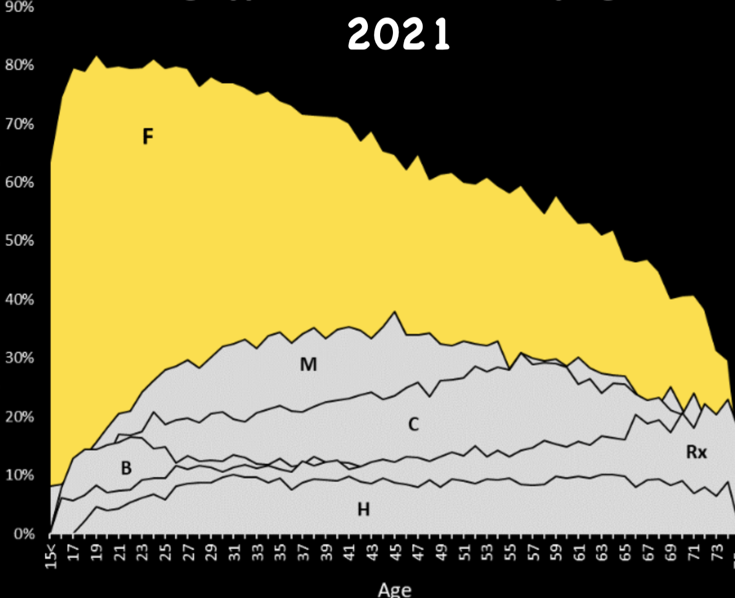
Drug Type Involvement (% of All Drug Death by Age)
Multiple Cause of Death Code*
Fentanyl Changes Everything

Slide 10
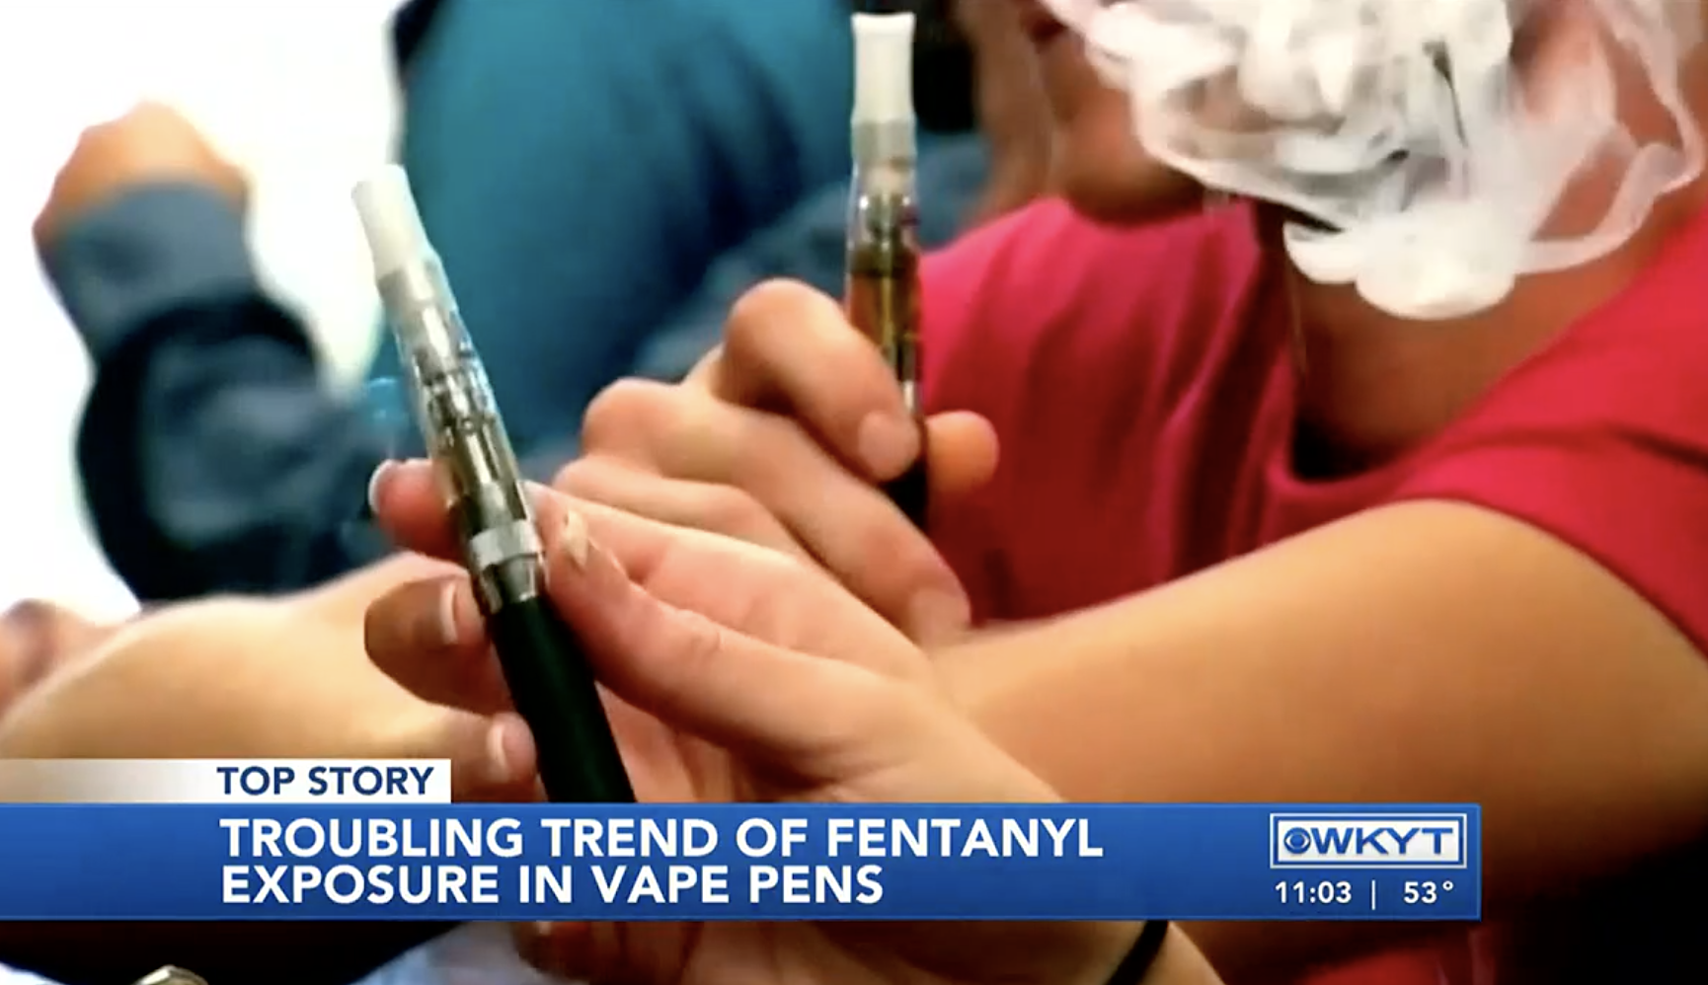
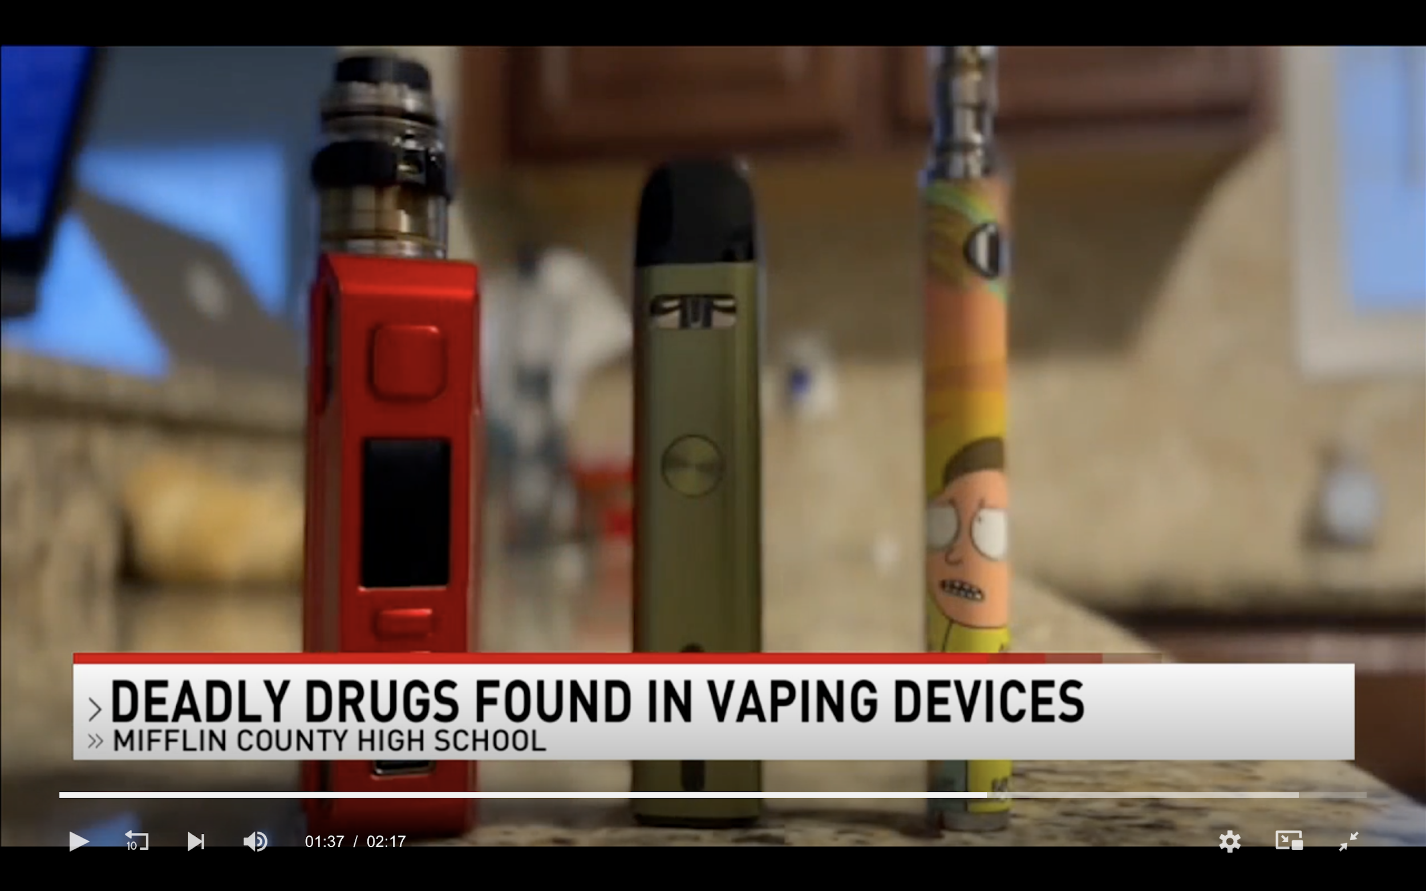
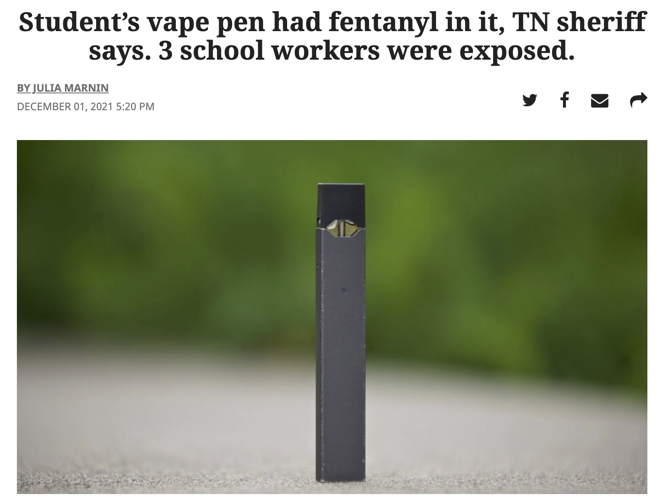
Fentanyl in Vapes
Vape pen at Sequoyah HS in Madisonville, TN on Nov 30th, 2021
1 Nurse & 2 SROs treated for symptoms of exposure (Narcan)
17 y.o. student arrested
Mifflin Co. High School, PA in late Feb 2022
3 vape pens found containing fentanyl or heroin
Student medical emergency--Investigation ongoing

Slide 11
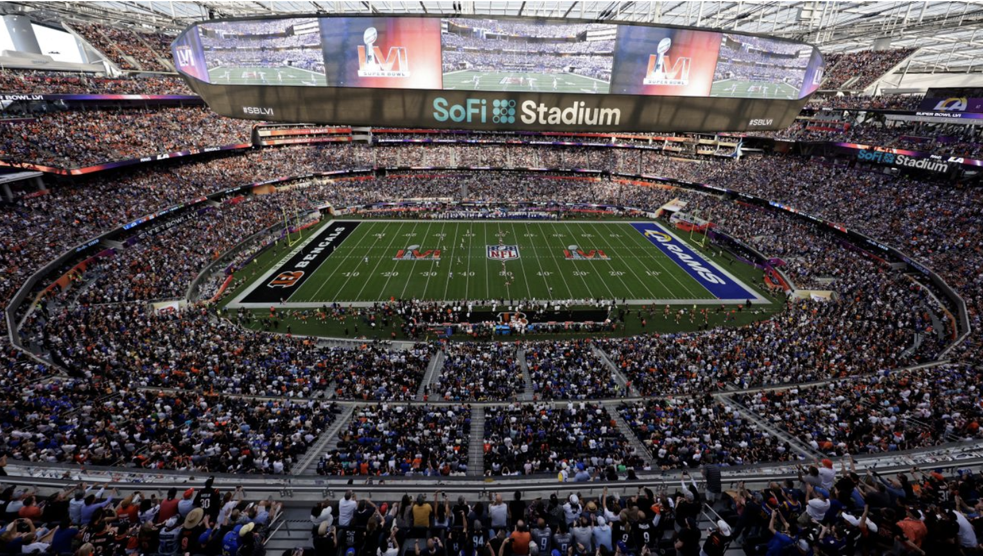
Fentanyl killed this many people in 2022

Slide 12
What was Rocklin Unified’s Response?

Slide 13
Rocklin Unified School District
Fentanyl Awareness Campaign
Spread awareness across RUSD stakeholders about the dangers of fentanyl use within the region.
Workshops.
Media.
Partner with outside agencies.
Narcan/Naloxone is in multiple AED Boxes across all campuses and school district buildings.
Staff training ongoing.

Slide 14
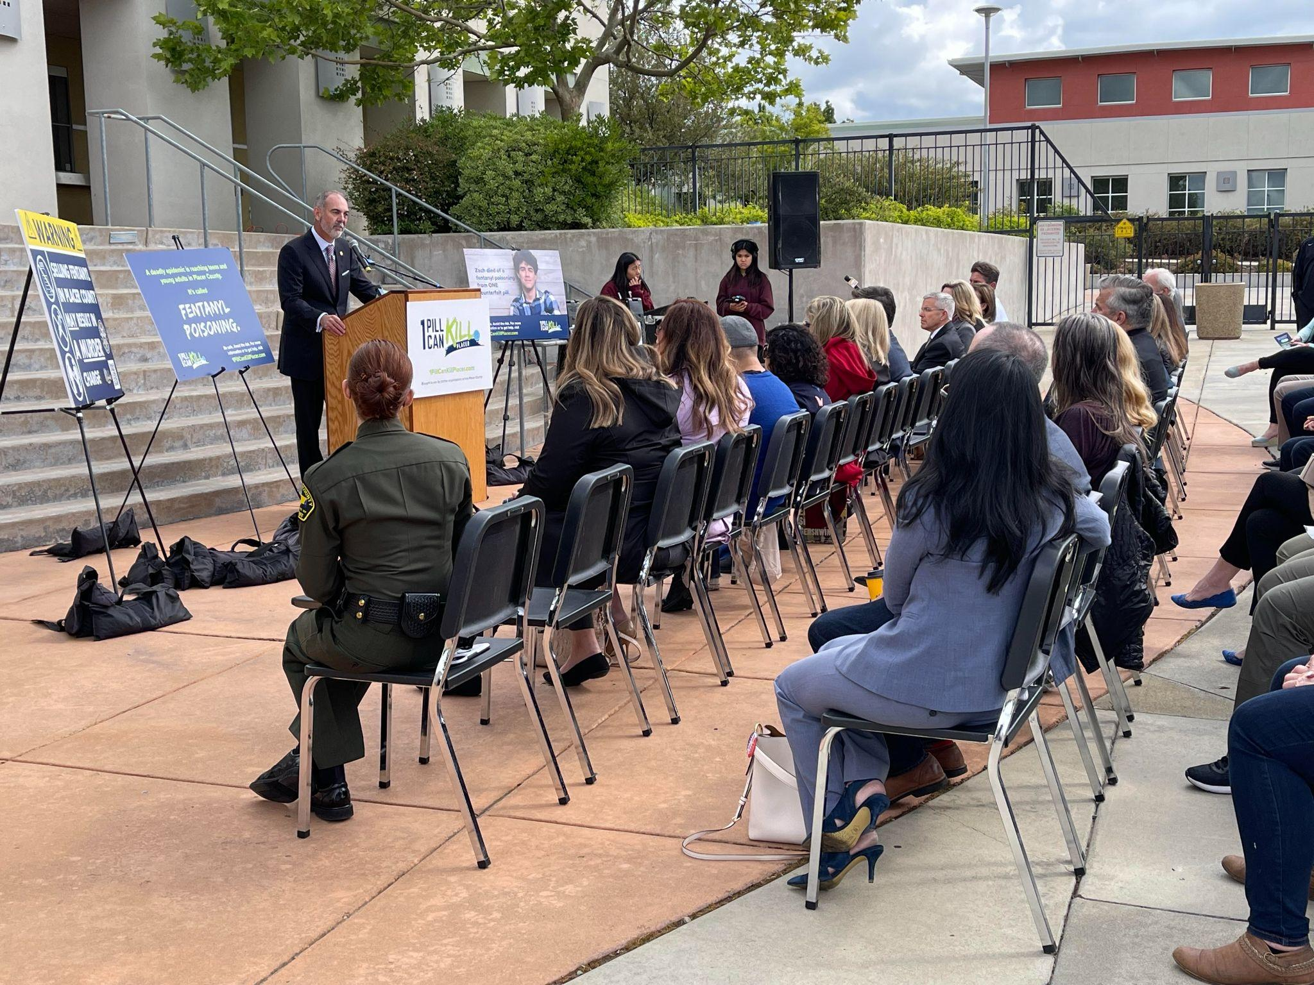
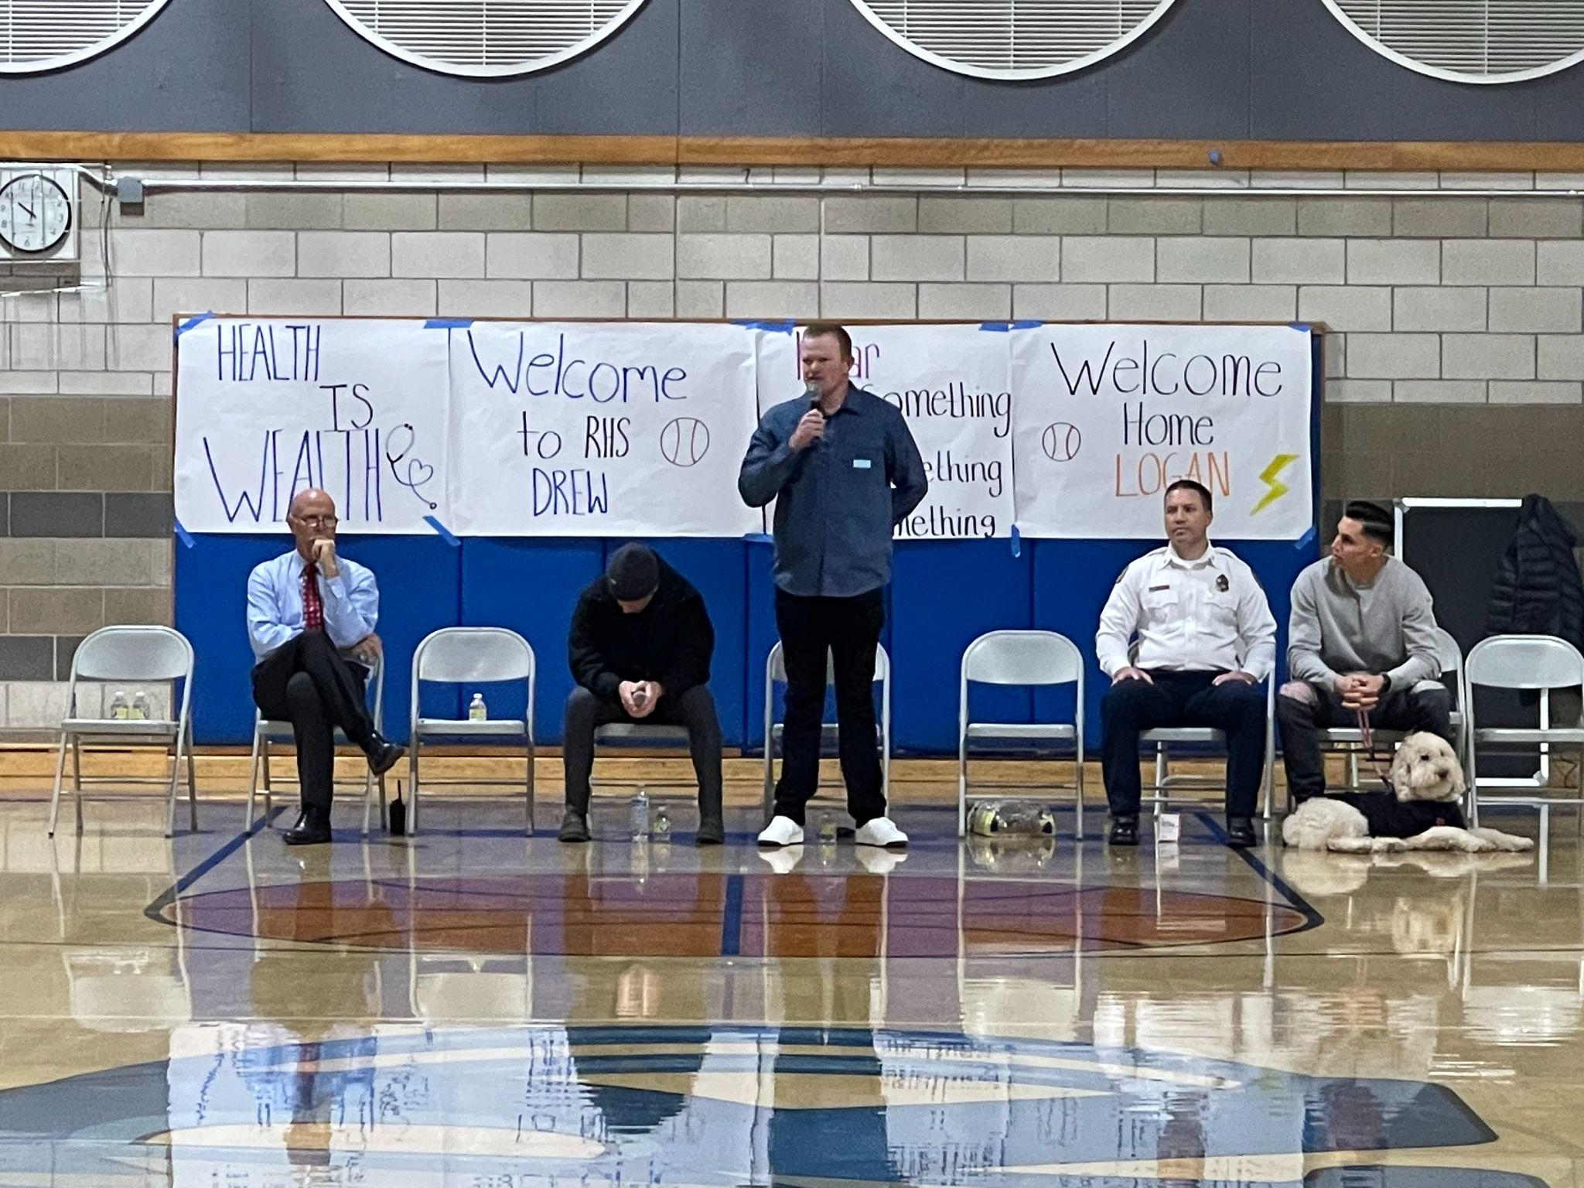
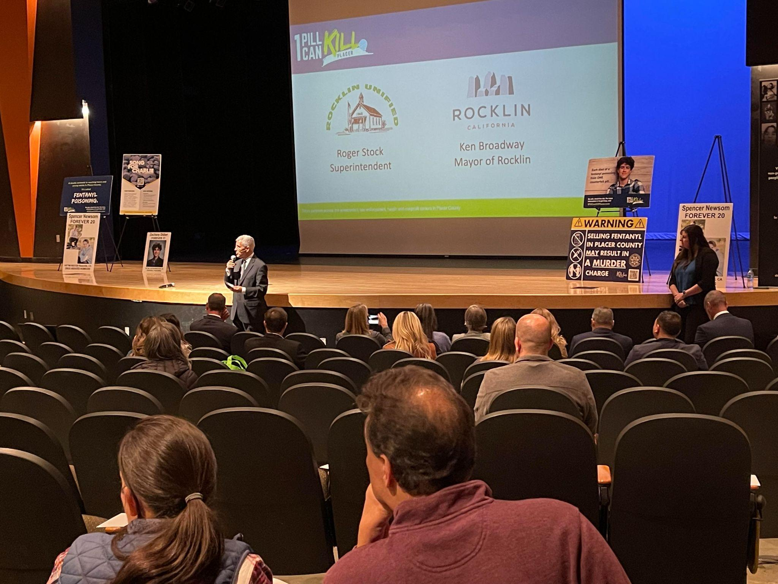
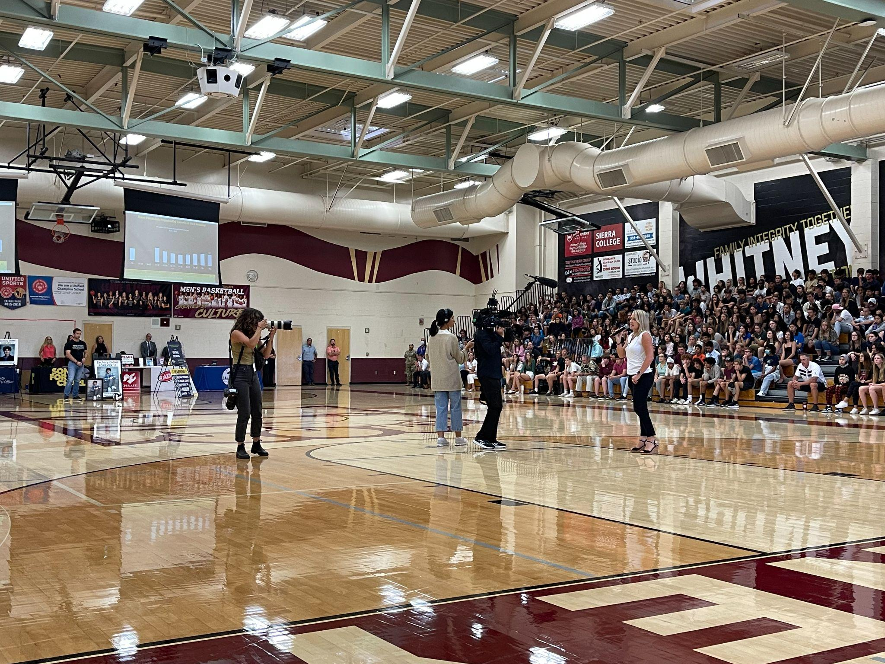
Rocklin Unified – Partnerships
Venue to launch 1 Pill Can Kill Placer Awareness Campaign
Parent Information Nights & Student Assemblies
Logan Webb, San Francisco Giants Pitcher & Rocklin High School Graduate

Slide 15
Rocklin Unified - Media Coverage

Slide 16
What happened at Riverside Unified?

Slide 17
Fentanyl Incident & Campaign
Overdose at one of our high schools - took a counterfeit oxycodone tablet containing fentanyl
Importance of Partnership with local law enforcement and emergency response teams
Partnership with the County and the Faces of Fentanyl Campaign launch in Oct.2022
Social Media Toolkit – English and Spanish
Faces of Fentanyl Website
Fentanyl deaths dashboard
Developed a Communications Plan for school site leaders and departments to use.
Narcan is now available at our school sites and training is currently taking place
Notes:
Overdose incident: https://www.riversideunified.org/our_district/rusd_news/a_joint_release_from_rusd_and_rpd (joint release with RPD)
On October 20 a female student at one of our high schools was inside the main office when she began experiencing a medical emergency. School staff began attending to the student when the Riverside Police School Resource Officer heard the commotion nearby. Paramedics were called and a dispatcher with the City of Riverside’s Public Safety Communications Center started giving medical aid instructions over the phone to staff.
The student stopped breathing and the school resource officer, assistant principal and other staff quickly initiated life-saving measures by doing CPR and preparing a school AED defibrillator. Their efforts revived the student. She started breathing and her pulse returned. Emergency services responded to the 911 call made by the school and administered narcan to the student based on suspicion of a drug overdose, to which she eventually regained full consciousness.
The school resource officer’s subsequent investigation determined that the student took a M30 pill, a suspected counterfeit oxycodone tablet containing fentanyl. The student purchased it through a social media platform and had it delivered to her home. Detectives with the Narcotics Unit took over the investigation and later were able to identify, locate, and arrest two people suspected of selling the M30 pill to this student.
On November 10 we received the official toxicology report then worked with RPD to get a joint statement out. We used the incident as an opportunity to remind parents of the dangers of drugs and added resources.
When this was happening, we were already collaborating with the County and were sharing their toolkit with school sites and posting their messages on social media.
We also added the web ad on all 50 school webpages, including the District and linked them to the facesoffentany.net campaign.
Family and employee newsletter message: Learn the signs and symptoms and how to keep your loved ones safe by visiting the Riverside County’s Faces of Fentanyl campaign at facesoffentanyl.net/
Superintendent Messaging: On another important note, I would like to report that District personnel began training school leaders on the use of Narcan. Narcan is the brand name for the medicine Nalaxone. This is a nasal spray that can be utilized in response to a suspected overdose of an opioid. With this first round of training, Narcan is now available at our school sites for use by trained personnel. Our next round of training will be for health assistants, assistant principals and identified campus supervisors. Learn the signs and symptoms and how to keep your loved ones safe by visiting the Riverside County’s Faces of Fentanyl campaign at facesoffentanyl.net/
Campaign Communications Plan - https://docs.google.com/document/d/138AflWirUQe40XM0FyboZ6ZXPQ59x_oFjiG78yq1sA4/edit

Slide 18
The Fentanyl Epidemic in Schools
Questions & Comments

