Slide 1
Superintendent COVID-19/Youth Health and Wellness Coordination
Google Drive linked here.
December 6, 2022
Notes:
Presenting: Stephanie Gomez, CBO

Slide 2
Today’s Topics
Public Health updates: wastewater & respiratory diseases
CDPH UPDATES
New Flyers: Who should take COVID-19 treatments? & COVID-19 Treatments Questions & Answers
Testing Framework for K–12 Schools for the 2022–2023 School Year updated 12/1/2022
Senate Bill 1479 Implementation Questions and Answers
Guidance for Local Health Jurisdictions on Isolation and Quarantine of the General Public updated 12/9/2022
CDPH Urges Californians to Take Preventative Measures to Stay Healthy this Winter
CDPH's Dr. Erica Pan Provides Guidance for Parents About Winter Viruses
DEC 8th – Webinar on Student Mental Health
OTC Test Distribution facilitated by SCCOE
Notes:
Presenting: Stephanie Gomez, CBO

Slide 3
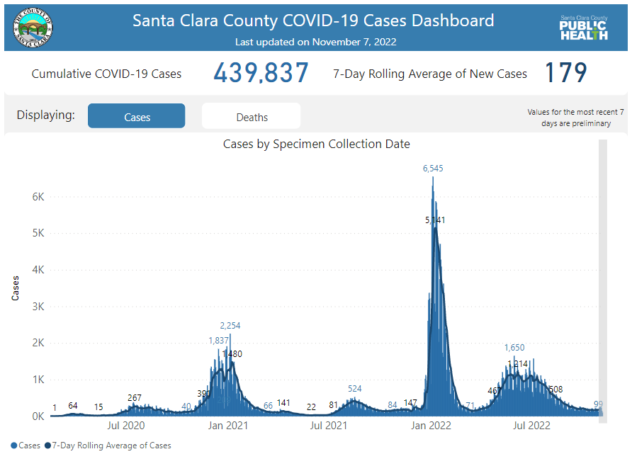
Comparison: November 7, 2022 to December 2, 2022
Notes:
Presenting:
Yeuen Kim MD MAS
Assistant health officer- extra help;
MPX disease investigation

Slide 4
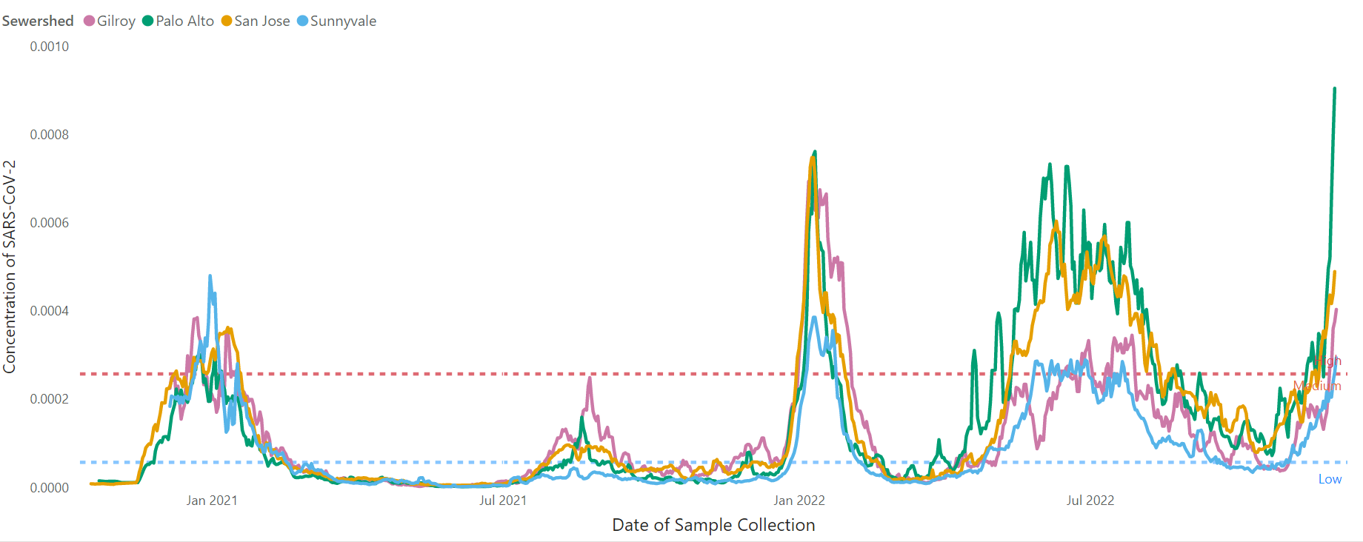
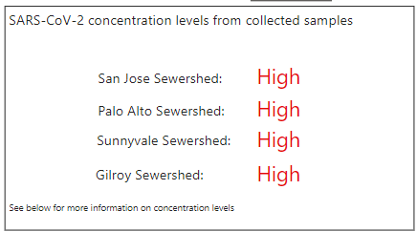
Concentration of COVID-19 in wastewater samples- Past 365 days
Last updated: 12/05/22
SARS-CoV-2 Wastewater Monitoring Data - County of Santa Clara
Notes:
Presenting:
Yeuen Kim MD MAS
Assistant health officer- extra help;
MPX disease investigation

Slide 5
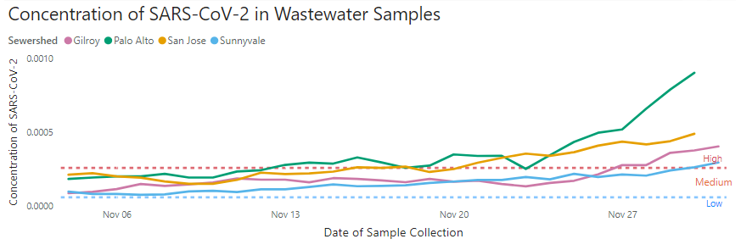
Concentration of COVID-19 in wastewater samples- Past 30 days
Last updated: 12/05/22
SARS-CoV-2 Wastewater Monitoring Data - County of Santa Clara
Notes:
Presenting:
Yeuen Kim MD MAS
Assistant health officer- extra help;
MPX disease investigation

Slide 6
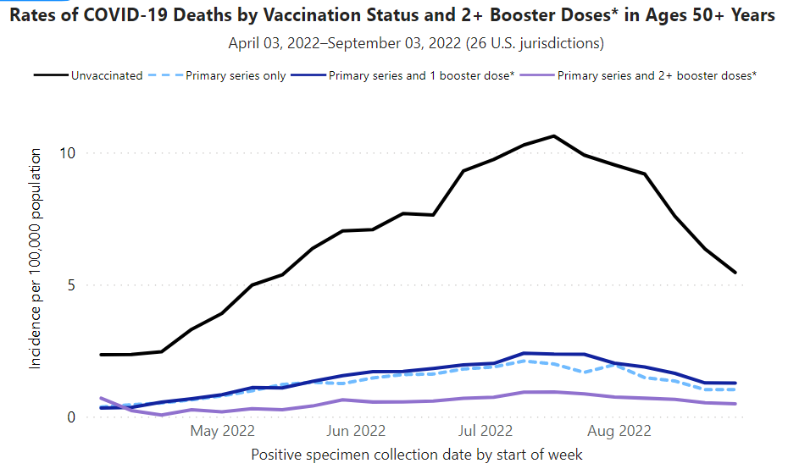
Booster is the best protector
Unvaccinated
Primary series and 2+ booster doses
CDC: Rates of COVID-19 Cases and Deaths by Vaccination Status
Notes:
Presenting:
Yeuen Kim MD MAS
Assistant health officer- extra help;
MPX disease investigation

Slide 7
Flu
INFLUENZA
Notes:
Presenting:
Yeuen Kim MD MAS
Assistant health officer- extra help;
MPX disease investigation

Slide 8
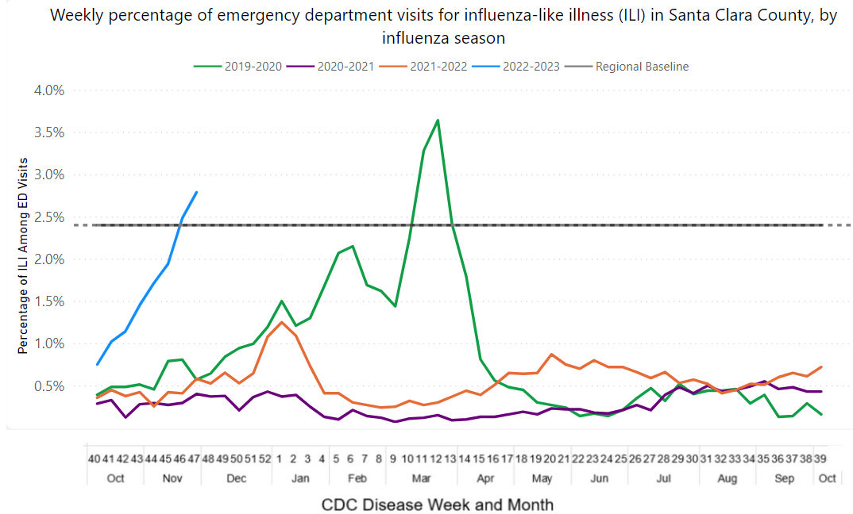
Flu continues to increase.
22-23 season
Last updated: 12/05/22
Influenza Report- County of Santa Clara
Notes:
Presenting:
Yeuen Kim MD MAS
Assistant health officer- extra help;
MPX disease investigation

Slide 9
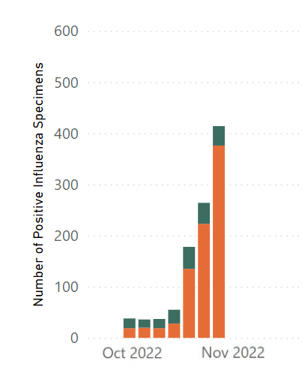
Influenza strain A is dominant
Influenza Report- County of Santa Clara
Notes:
Presenting:
Yeuen Kim MD MAS
Assistant health officer- extra help;
MPX disease investigation

Slide 10
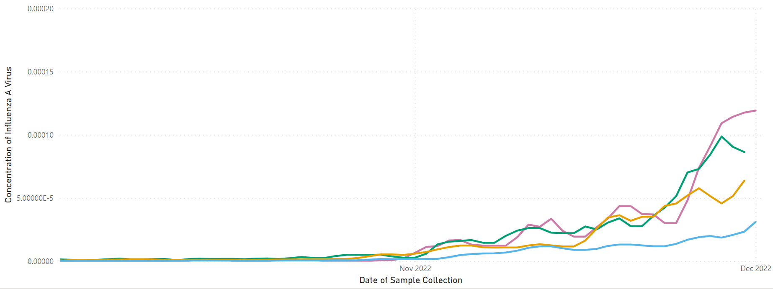
New flu wastewater dashboard
Last updated: 12/05/22
Influenza Wastewater Dashboard
Notes:
Presenting:
Yeuen Kim MD MAS
Assistant health officer- extra help;
MPX disease investigation

Slide 11
RSV
RESPIRATORY SYNCYTIAL VIRUS
Notes:
Presenting:
Yeuen Kim MD MAS
Assistant health officer- extra help;
MPX disease investigation

Slide 12
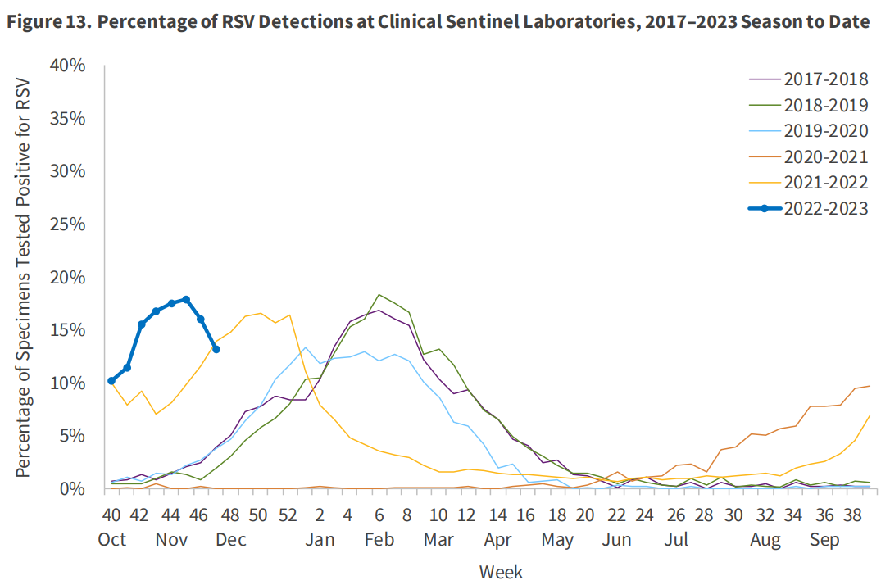
RSV detections
22-23 season
RSV remains higher than in the previous 5 seasons.
RSV detections between Nov. 20-26 have decreased.
Influenza (ca.gov)
Notes:
Presenting:
Yeuen Kim MD MAS
Assistant health officer- extra help;
MPX disease investigation

Slide 13
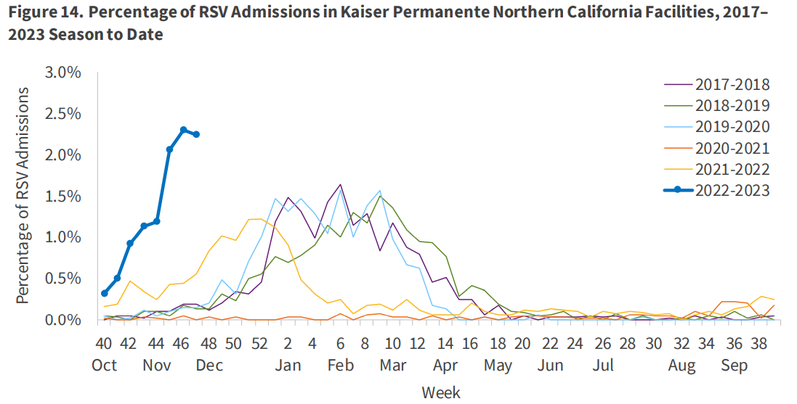
RSV hospital admissions
22-23 season
Influenza (ca.gov)
Notes:
Presenting:
Yeuen Kim MD MAS
Assistant health officer- extra help;
MPX disease investigation

Slide 14
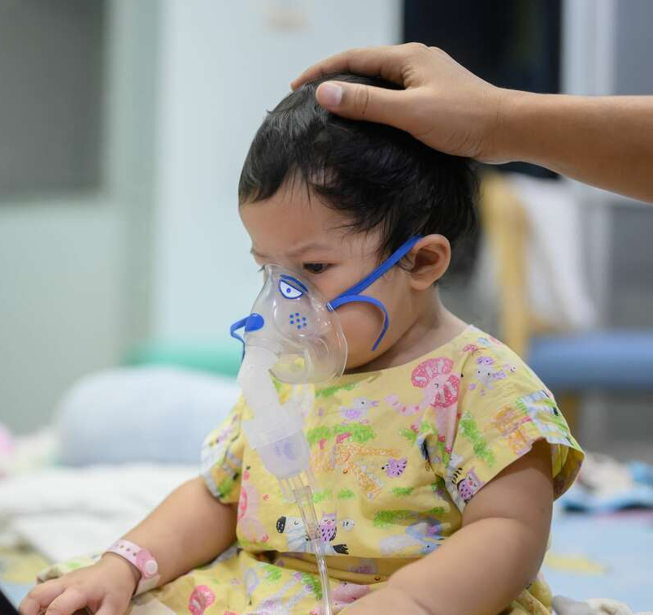
Exclude students with symptoms
Schools should be looking for cold-like symptoms and exclude, per normal sick protocols.
RSV symptoms in school-aged children are the same as in babies and toddlers.
Symptoms of RSV:
Congested or runny nose
Dry cough
Low-grade fever
Sore throat
Sneezing
Headache
Notes:
Presenting:
Yeuen Kim MD MAS
Assistant health officer- extra help;
MPX disease investigation

Slide 15
CDPH's RSV page
See CDPH's resource on RSV.
Topics covered:
Symptoms of RSV
Caring for children with RSV
When to return to school or childcare after RSV
"Individuals may return to work/school/childcare after symptoms have resolved, including waiting at least 24 hours since resolution of fever without the use of fever-reducing medications."
Notes:
Presenting:
Yeuen Kim MD MAS
Assistant health officer- extra help;
MPX disease investigation

Slide 16
New Resource: Who should take COVID-19 treatments?
Notes:
Presenting:
Yeuen Kim MD MAS
Assistant health officer- extra help;
MPX disease investigation

Slide 17
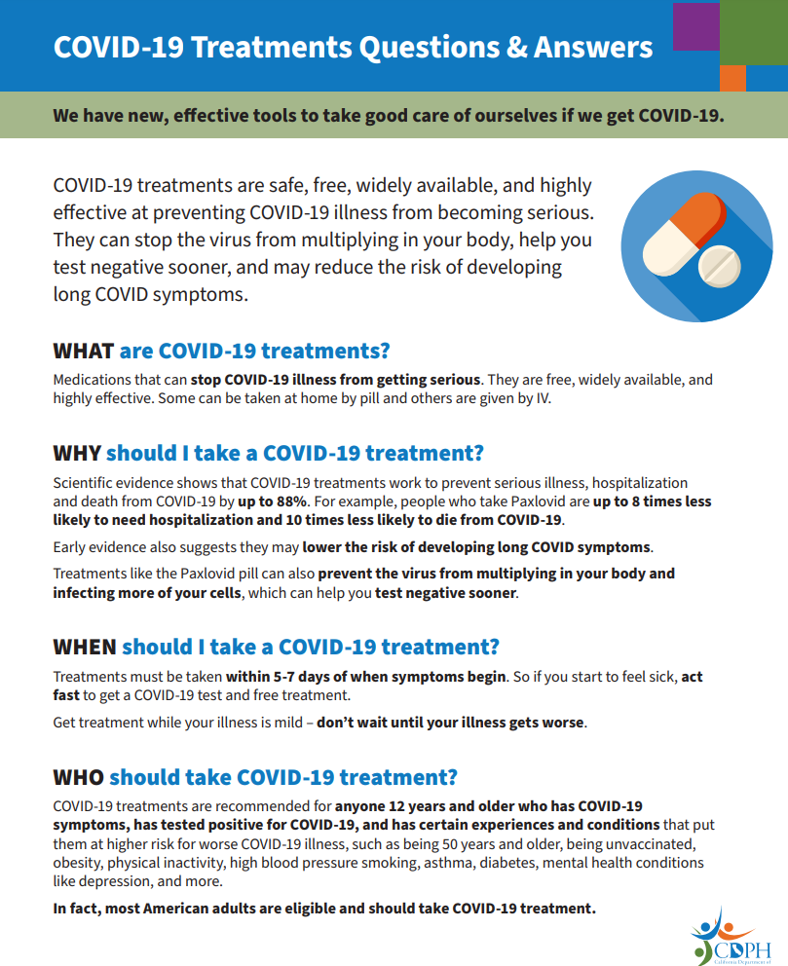
New Resource: COVID-19 Treatments Questions & Answers
Notes:
Presenting:
Yeuen Kim MD MAS
Assistant health officer- extra help;
MPX disease investigation

Slide 18
For more information about COVID-19 treatments and help with finding treatment, call the statewide COVID-19 hotline at 833-422-4255.
The statewide call center is open 7 days a week:
Monday-Friday, 8:00 AM to 8:00 PM Pacific Time
Saturday and Sunday, 8:00 AM to 5:00 PM Pacific Time

Slide 19
School Testing Framework, Q&A for 2022-23 School Year, Q&A for SB1479
In 2022/23, schools can continue to partner with the California Department of Public Health (CDPH) Testing Task Force for testing resources and support. Please see our 2022-23 Framework and corresponding Q&As for more information:
Testing Framework for K-12 Schools for the 2022-2023 School Year (Updated)
School Testing Framework 2022-23 Frequently Asked Questions
K-12 Guidance for the 2022-23 School Year
Senate Bill 1479 Implementation Questions and Answers (ca.gov) (New)
Notes:
Presenting:
Damicela Calhoun, MPH (she/her)
Pronounced: Dom-E-sella
Health Education Specialist
COVID-19 Education and Outreach
County of Santa Clara, Public Health Department

Slide 20
Testing Framework for K–12 Schools for the 2022–2023 School Year
Updated December 1, 2022
The following are recommended practices for California districts, schools, and county offices of education:
Identify a COVID Testing Point of Contact to facilitate communication and coordination with the CA Testing Task Force along with other relevant agencies or organizations that oversee school operations.
Review and reference current testing recommendations provided in the CDPH K-12 School COVID Guidance and any additional recommendations or requirements provided by the Local Health Jurisdiction.
Maintain situational awareness of the testing resources and programs offered by the CA Testing Task Force and monitor availability of pre-positioned testing resources housed with a County Office of Education or Local Health Jurisdiction for rapid distribution to schools.
Monitor the CDC's COVID Community Data Tracker as a method of identifying when to increase or reestablish school testing operations.
Communicate any questions, concerns, or additional operational testing resources/needs to the CA Testing Task Force at schooltesting@cdph.ca.gov
Notes:
Presenting:
Damicela Calhoun, MPH (she/her)
Pronounced: Dom-E-sella
Health Education Specialist
COVID-19 Education and Outreach
County of Santa Clara, Public Health Department

Slide 21
Testing Framework for K–12 Schools for the 2022–2023 School Year
Updated December 1, 2022
The following list describes operational considerations for COVID-19 testing for K-12 schools:
California is currently offering direct ordering of COVID-19 over-the-counter (OTC) tests to schools. Schools may use OTC tests to supplant on-site testing in many situations. Such efforts should be paired with educational materials to facilitate proper OTC use, particularly in communities with limited English proficiency and/or lower health literacy.
California also offers COVID-19 OTC tests to all county offices of education (COEs) for use by public and private school students and staff for return from various prolonged school holiday break testing, such as summer and winter breaks. California Department of Public Health (CDPH) has communicated with COEs about a 2022-2023 Winter Break distribution; for more information, please contact your local COE or email schooltesting@cdph.ca.gov.
Notes:
Presenting:
Damicela Calhoun, MPH (she/her)
Pronounced: Dom-E-sella
Health Education Specialist
COVID-19 Education and Outreach
County of Santa Clara, Public Health Department

Slide 22
Testing Framework for K–12 Schools for the 2022–2023 School Year
Updated December 1, 2022
The following list describes operational considerations for COVID-19 testing for K-12 schools:
CDPH recommends that antigen tests be considered the primary option for detecting COVID-19 in schools, rather than PCR tests. Both the professional, on-site antigen tests as well as the OTC at-home antigen tests have been effective in identifying persons who have infectious levels of all known variants of SARS-CoV-2. PCR tests are highly sensitive, but their utility is greatest as a confirmatory test in appropriate situations and/or in clinical settings. If you are currently participating in a CDPH school-based PCR testing program, please email schooltesting@cdph.ca.gov for more information about transitioning to an antigen testing program, and to learn more about available resources.
CDPH will continue to support professional on-site antigen testing programs in the 2022-2023 school year. However, the volume of anticipated on-site testing is likely to decrease with the increased availability and ease of OTC tests. We anticipate the workload for on-site testing to substantially decrease for the 2022-2023 school year as OTC testing will often meet testing needs. Thus, state support for school-based testing staff (via End-to-End vendors) will be reduced. For more information, please email schooltesting@cdph.ca.gov.
Notes:
Presenting:
Damicela Calhoun, MPH (she/her)
Pronounced: Dom-E-sella
Health Education Specialist
COVID-19 Education and Outreach
County of Santa Clara, Public Health Department

Slide 23
Testing Framework for K–12 Schools for the 2022–2023 School Year
Updated December 1, 2022
CDPH recommends that antigen tests be considered the primary option for detecting COVID-19 in schools, compared to PCR tests.
If used, PCR or other molecular testing may be considered in limited situations in the school setting:
People with symptoms who may have a negative initial antigen test AND are at high risk for hospitalization or death from COVID-19 benefit from early treatment. They may consider PCR (or other molecular) test and/or repeat an antigen test (at-home tests are acceptable) in 24 hours if the PCR result has not returned (Updated Testing Guidance). Individuals may consider repeat antigen testing every 24-48 hours until a positive test is returned or until symptoms improve.
When a participant has ambiguous or invalid antigen test results, even on a repeat test, schools can consider repeating an antigen test in 24-48 hours, or PCR testing as an alternative.
Notes:
Presenting:
Damicela Calhoun, MPH (she/her)
Pronounced: Dom-E-sella
Health Education Specialist
COVID-19 Education and Outreach
County of Santa Clara, Public Health Department

Slide 24
Questions and Answers SB 1479
Can an LEA adopt the CDPH guidance to fully satisfy the requirement of having a COVID-19 testing plan?
Yes, SB 1479 allows LEAs to either create a COVID-19 testing plan or adopt the Framework.
Where does the COVID-19 testing plan need to be posted?
The bill specifies that the COVID-19 testing plan or Framework be posted on each LEA's internet website.
Notes:
Presenting:
Damicela Calhoun, MPH (she/her)
Pronounced: Dom-E-sella
Health Education Specialist
COVID-19 Education and Outreach
County of Santa Clara, Public Health Department

Slide 25
Questions and Answers SB1479
What types of LEAs are included in the provisions of SB 1479?
The bill defines LEAs as a school district, county office of education, or charter schools serving students in kindergarten or any grades 1 to 12, inclusive.
Does an LEA's COVID-19 testing plan cover all schools in the LEA?
Yes.
Notes:
Presenting:
Damicela Calhoun, MPH (she/her)
Pronounced: Dom-E-sella
Health Education Specialist
COVID-19 Education and Outreach
County of Santa Clara, Public Health Department

Slide 26
Questions and Answers SB1479
Are LEAs required to maintain on-site testing programs?
No, the bill specifies that testing plans are not required to include onsite testing.
Are LEAs required to submit the COVID-19 testing plan to CDPH for approval?
No, however, support services are available by CDPH that include, but are not limited to, technical assistance, vendor support, guidance, monitoring, and testing education.
Do I need to hire someone to track school-related testing?
No, however, SB 1479 says an LEA "may" designate one staff member to report information on its COVID-19 testing program to CDPH.
Notes:
Presenting:
Damicela Calhoun, MPH (she/her)
Pronounced: Dom-E-sella
Health Education Specialist
COVID-19 Education and Outreach
County of Santa Clara, Public Health Department

Slide 27
Guidance for Local Health Jurisdictions on Isolation and Quarantine of the General Public
Updates as of November 9, 2022:
Updated definition of close contact.
Updated time during which infected persons should not test, shortening the time from 90 days to 30 days, based on recent CDC recommendations.
Removed Table 3 recommendations for work exclusion and quarantine for correctional facilities and homeless, emergency and cooling/warming shelters, consistent with recent CDC recommendations.
Clarified that healthcare personnel working in settings not covered by AFL 21-08.8 may follow the guidance outlined in AFL 21-08.8, and that skilled nursing facilities should follow the guidance for management of exposed residents in AFL 22-13.1.
Notes:
Presenting:
Damicela Calhoun, MPH (she/her)
Pronounced: Dom-E-sella
Health Education Specialist
COVID-19 Education and Outreach
County of Santa Clara, Public Health Department

Slide 28
CDPH Urges Californians to Take Preventative Measures to Stay Healthy this Winter
Get Vaccinated, Boosted (and Treated) Flu and COVID-19 vaccines continue to be your best defense to limit severe illness and death – and you can get both at the same time. If you test positive for COVID-19, contact your doctor or a test-to-treat site immediately to seek treatment. Treatments work best when started right after symptoms begin.
Stay Home if You're Sick! It's crucial to stay home if you are feeling ill. Avoid close contact with others to protect them, and take the time you need to heal. This is especially important for respiratory viruses like the flu, RSV and COVID-19, which can lead to more severe illness.
Wear a Mask There is no vaccine for RSV, so wearing a mask can significantly slow the spread and protect babies and young children who do not yet have immunity and are too young to wear a mask themselves. Wearing a mask in indoor public places is a good way to limit the spread of germs.
Wash Your Hands Frequent handwashing, with soap and warm water – for at least 20 seconds, is an easy and very effective way to prevent getting sick and spreading germs.
Cover Your Cough or Sneeze Remember to cough or sneeze into your elbow, your arm, or a disposable tissue to help prevent the spread of winter viruses. Just make sure to wash your hands or sanitize and dispose of your tissue after.
Notes:
Presenting:
Damicela Calhoun, MPH (she/her)
Pronounced: Dom-E-sella
Health Education Specialist
COVID-19 Education and Outreach
County of Santa Clara, Public Health Department

Slide 29
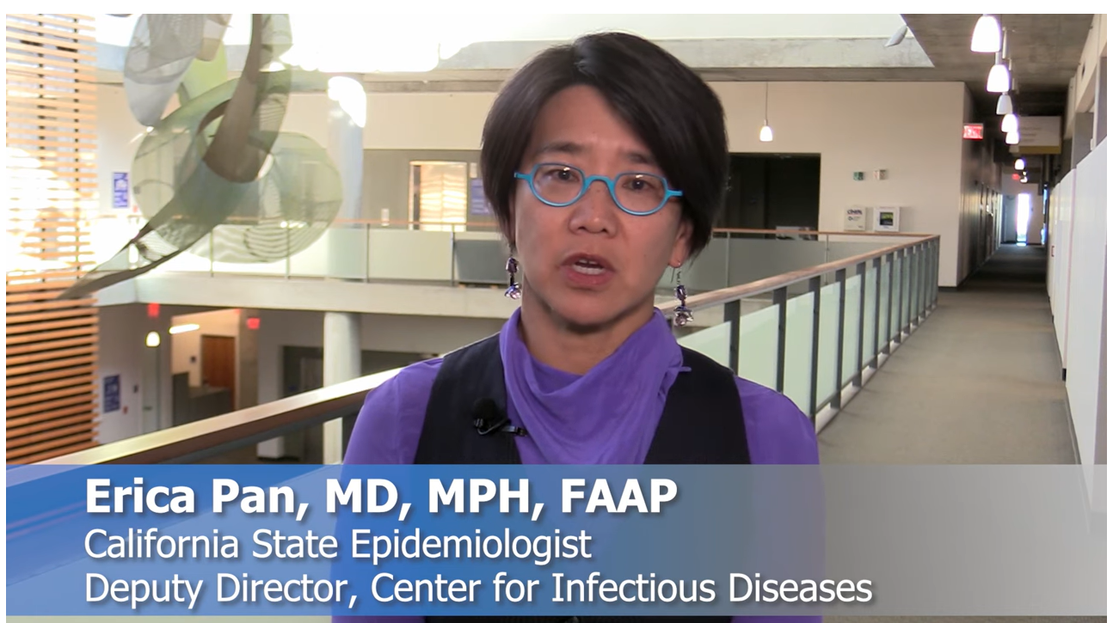
VIDEO: Stay Healthy this Winter: Tips to Protect Yourself and Family
CDPH continues to monitor hospitalizations related to winter respiratory viruses, including flu, COVID-19, and RSV, as well as trends across the country and state. With many viruses already circulating at high levels in California, it is important to take these measures to ensure our hospitals have capacity to care for all vulnerable Californians, including babies and children, who need lifesaving treatment.
Notes:
Presenting:
Damicela Calhoun, MPH (she/her)
Pronounced: Dom-E-sella
Health Education Specialist
COVID-19 Education and Outreach
County of Santa Clara, Public Health Department

Slide 30
K-12 Schools Community Forum: Caring for students in the wake of COVID-19
Presented by the California COVID-19 Virtual Training Academy (VTA+), this webinar is intended for California school and district level staff, students, families and partners including public health and county offices of education.
Register Here!
Notes:
Presenting:
Damicela Calhoun, MPH (she/her)
Pronounced: Dom-E-sella
Health Education Specialist
COVID-19 Education and Outreach
County of Santa Clara, Public Health Department

Slide 31
REFERENCES &
RESOURCES
Notes:
Presenting: Stephanie Gomez, CBO

Slide 32
Bivalent booster available to public!​
Designed to protect against Omicron subvariants BA.4 and BA.5 and original COVID-19 strain.​
Get the booster at least two months after completing primary or booster vaccination.​
Request a free pop-up vaccination clinic from CDPH:
Open to schools, childcare centers, community organizations, employers, and more.​
Should have 50+ interested participants per day, per event.
Notes:
Presenting:
Alison Sikola, RN, PHN, MS
Public Health Nurse Manager I
COVID Prevention and Control Program

Slide 33
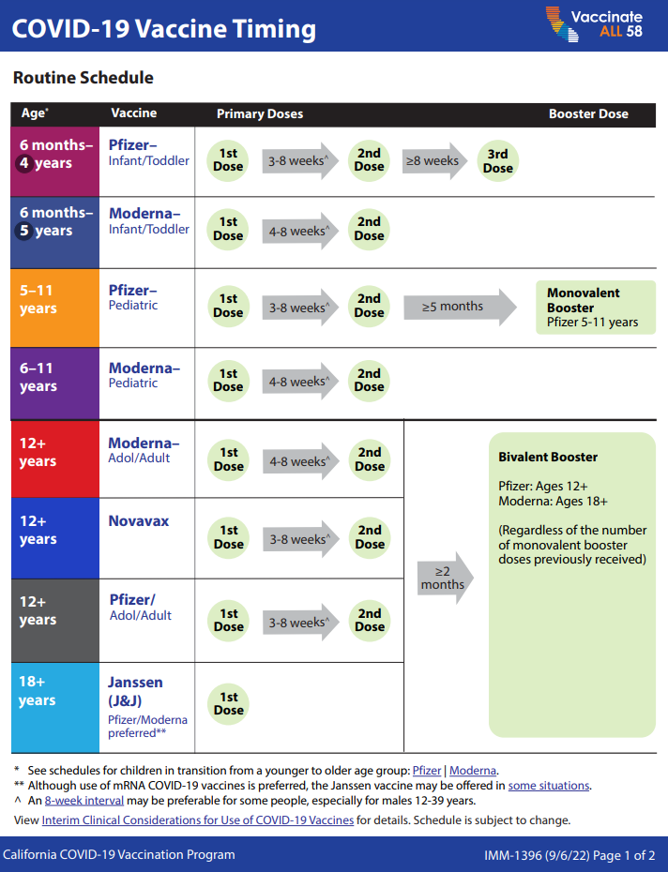
Booster schedule
See CDPH’s COVID-19 Vaccine Timing Resource
Notes:
Presenting
Damicela Calhoun, MPH (she/her)
Pronounced: Dah-mi-sella
Health Education Specialist

Slide 34
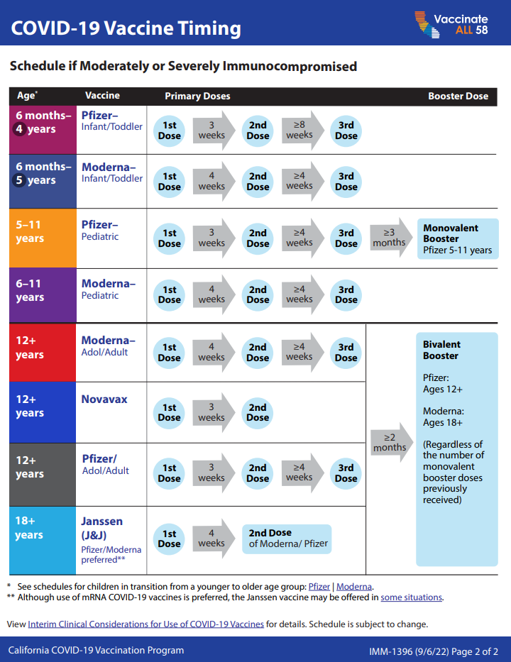
Notes:
Presenting
Damicela Calhoun, MPH (she/her)
Pronounced: Dah-mi-sella
Health Education Specialist

Slide 35
State Public Health Officer Order of October 14, 2022
Updates as of October 14, 2022: Updated definition of close contact to provide entities strategies to prioritize response to potential exposures.
Exposures in indoor spaces less than 400,000 cubic feet per floor:
Sharing the same indoor airspace for a cumulative total of 15 minutes or more over a 24-hour period during an infected person's infectious period.
Spaces that are separated by floor-to-ceiling walls are considered distinct indoor airspaces.
Most or all designees work in spaces fewer than 400,000 cubic feet.
Exposures in large indoor spaces greater than 400,000 cubic feet per floor:
•Being within 6 feet of the infected person for a cumulative total of 15 minutes or more over a 24-hour period during the infected person's infectious period.
•Very unlikely for any designees to work in spaces this large.
Notes:
Damicela Calhoun, MPH (she/her)
Pronounced: Dom-E-sella
Health Education Specialist
COVID-19 Education and Outreach

Slide 36
Your Leadership
Look to wastewater data to understand how much COVID is currently in your communities.
Encourage behavior change. COVID is still spreading, making many people sick every day.
Promote vaccination and booster shots
Encourage your communities to wear a high-quality mask indoors
Ensure there is proper ventilation when gathering indoors, especially during the holidays
Advise constituents to test before and after gatherings
Continue partnerships for wastewater monitoring.
Your City government wastewater agency is partnering with the County to make this possible.
Notes:
Presenting:
Yeuen Kim MD MAS
Assistant health officer- extra help;
MPX disease investigation

Slide 37
Post-COVID Conditions (Long COVID)
Some people have new, returning, or lingering symptoms weeks to months after having COVID-19. This condition can be called many names including post-COVID conditions, long COVID, long haul COVID, and Post-Acute Sequelae of COVID-19 (PASC).
People with these conditions are sometimes called “long-haulers.” Since July 2021, post-COVID conditions have been considered a disability under the Americans with Disabilities Act (ADA).
Anyone who had COVID-19 can develop a post-COVID condition, including people who had COVID-19 with no symptoms or very mild symptoms. People in any age group can develop post-COVID conditions, but they appear to be less common in children compared to adults. There is still a lot we do not know about post-COVID conditions, and this is an area of active research.
Learn more about post-COVID conditions: Post-COVID Conditions (Long COVID) Questions and Answers.
Notes:
Presenting:
Presenting:
Yeuen Kim MD MAS
Assistant health officer- extra help;
MPX disease investigation

Slide 38
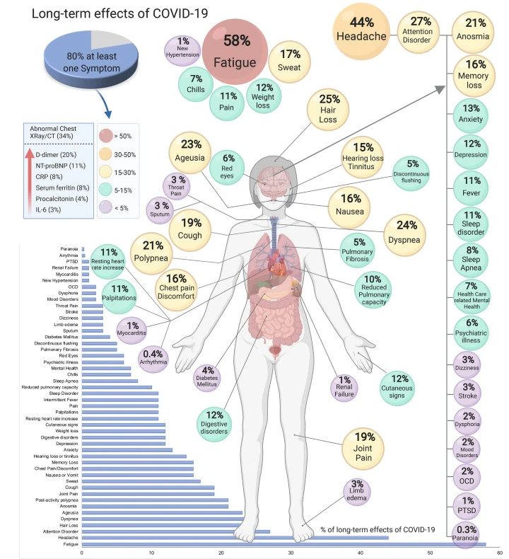
More than 50 long-term effects of COVID-19: a systematic review and meta-analysis
Hopeful: 2022 meta-analysis of 18 studies
• Long-COVID19 not as prevalent as 2021,
• Severe COVID19 less frequent,
• Immunity (vaccinations/infection) better
Notes:
Presenting:
Presenting:
Yeuen Kim MD MAS
Assistant health officer- extra help;
MPX disease investigation

Slide 39
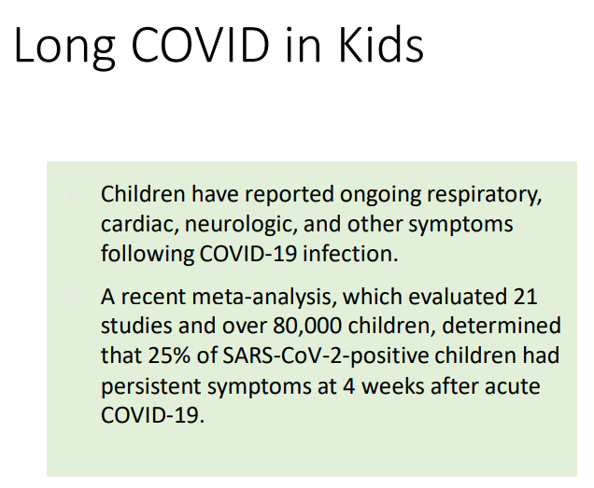
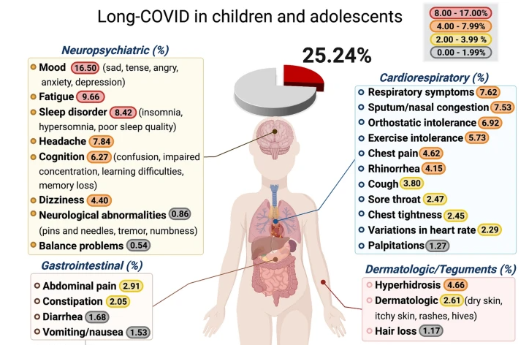
Notes:
Presenting:
Yeuen Kim MD MAS
Assistant health officer- extra help;
MPX disease investigation

Slide 40
​Considerations for Child Care and School Settings
CDPH recently published MPX Considerations for Child Care and School Settings
“Notification of MPX cases on school or childcare site NOT needed for individuals who are not exposed according to Public Health Department”
Takeaway:
If a person with MPX symptoms was at your childcare facility or school site, you should contact the County of Santa Clara Public Health Department* for further assistance.
For exposed/contacts of someone with MPX, no quarantine is needed. If positive for MPX, they must isolate: sccphd.org/mpx
*MPXcase@PHD.sccgov.org or (408)792-3720 for MPX information (Eng/Spanish)
Notes:
Presenting:
Dr. Kim, Assistant Public Health Officer
and Sara Stahlberg
Sara Stahlberg, MPH
Program Manager III | COVID Prevention & Control

Slide 41
Winter sports & MPX
New educational materials from Public Health about contact sports and risk of MPX.
Questions/concerns:
mpxcase@phd.sccgov.org
MPX line (408) 792-3720
M-F 8-5pm English/Spanish
Notes:
Presenting:
Yeuen Kim MD MAS
Assistant health officer- extra help;
MPX disease investigation

Slide 42
Fentanyl Resources
www.cdph.ca.gov/StopOverdose
CDPH’s Naloxone Standing Order
DHCS’s Naloxone Distribution Project
CDPH Page On Fentanyl (ca.gov)
Recent News: Rainbow Fentanyl Alert (ca.gov)
General Information About Naloxone
Fresno County Webpage: Fentanyl Danger in Fresno County | County of Fresno
Fentanyl Awareness and Prevention information (including videos developed by Fresno County) are in the latest version of SHARE, which can be found here - https://schools.covid19.ca.gov/pages/share
CDPH Safe Schools Hub - https://schools.covid19.ca.gov/
Notes:
Presenting: Dr. Dewan

Slide 43
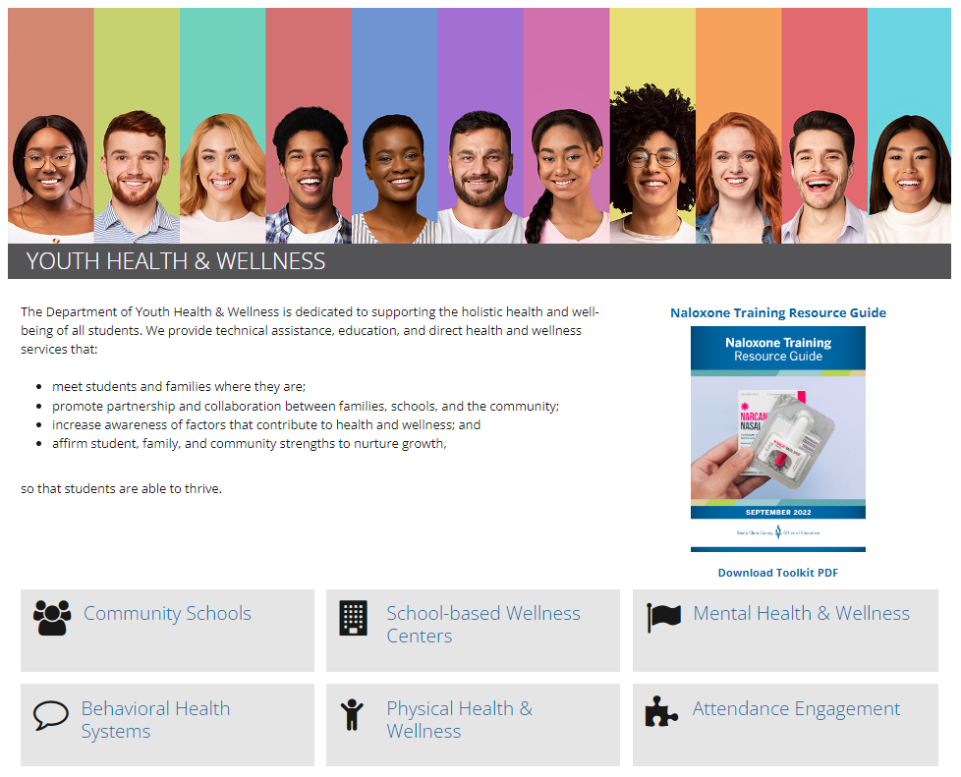
Naloxone Training Resource Guide
YHW_Naloxone_Training_Guide_SEPT2022.pdf (sccoe.org)
Notes:
Presenting: Dr. Dewan

Slide 44
Online Training for Schools
Welcome to free online training for schools TK–12th grades! These interactive modules are designed to support your efforts in implementing school immunization requirements.
Become an Immunization Champion for Your School!
Please see the list of training modules and objectives below. Click on the links to begin.
Notes:
Damicela Calhoun, MPH (she/her)
Pronounced: Dom-E-sella
Health Education Specialist
COVID-19 Education and Outreach

Slide 45
To schedule an initial consultation for you or your team, complete this form: https://forms.gle/Gq6fj9KHkobQTSSC9
To learn more, contact Karessa Paulino @ kpaulino@sccoe.org.
Notes:
Presenting: Dr. Dewan

Slide 46
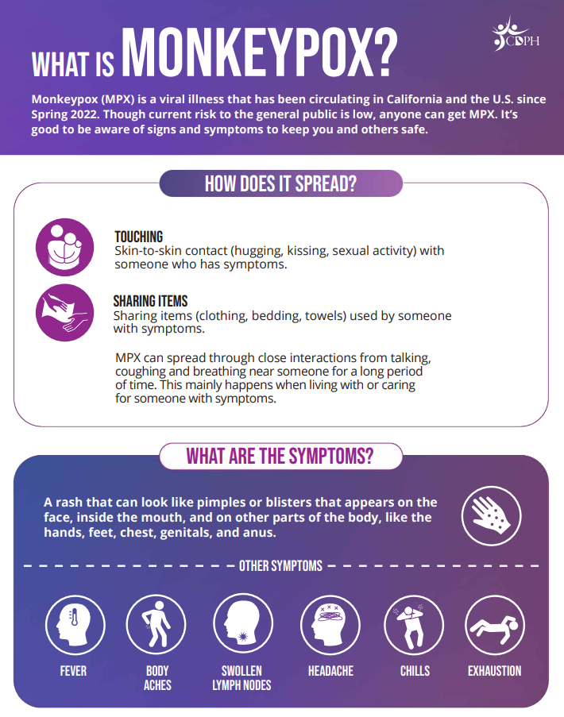
Fact Sheet for general public
Notes:
Presenting:
Dr. Kim, Assistant Public Health Officer
and Sara Stahlberg
Sara Stahlberg, MPH
Program Manager III | COVID Prevention & Control

Slide 47
Guidance and General Questions
David Putney, Director of Special Projects
dputney@sccoe.org
(408) 453-6721
Notes:
Presenting: Dr. Dewan

Slide 48
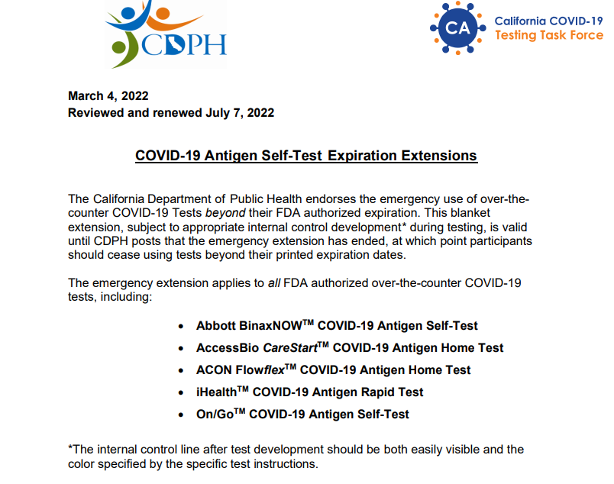
COVID-19 Antigen Self-Test Expiration Extensions (ca.gov)
Notes:
Presenting: Dr. Dewan

Slide 49
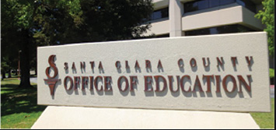
COVID Testing at SCCOE
Observed self-administered nasal swab testing for COVID-19
Where & When:
Tuesdays @ Santa Clara County Office of Education, 1290 Ridder Park Dr., San Jose, CA, 95131, San Jose Room
10 am- 2 pm & 3-6 pm
Wednesday @ South County Annex
South County Annex, 9300 Wren Ave, Gilroy, CA 95020
10 am- 2 pm & 3-6 pm
Appointments and walk ups welcome. Appointments can be made in English and Spanish by calling 1-888-634-1123 or visiting lhi.care/covidtesting
To Schedule an Appointment, click here
Notes:
Presenting: Dr. Dewan

Slide 50
Superintendents’ COVID-19/
Youth Wellness Coordination Meeting Schedule
Jan. 31
Mar. 14
Apr. 25
June 6
Notes:
Presenting: Dr. Dewan

Slide 51
COVID 19 Designees
Meeting Schedule
November 10th
December 8th
December 8th
January 12th
January 26th
February 9th
February 23rd
March 9th
March 23rd
April 6th
April 20th
May 4th
May 18th
June 1st
June 15th
June 29th
Office Hours are held in the weeks between meetings.
Notes:
Presenting: Dr. Dewan

Slide 52
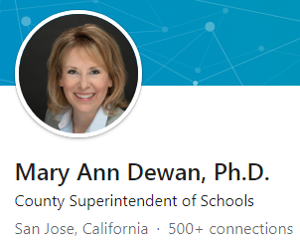
Thank you!
Mary Ann Dewan, Ph.D.
County Superintendent
Santa Clara County Office of Education
MDewan@sccoe.org
Connect with SCCOE
Social Media
Ed Bulletin (e-newsletter)
www.sccoe.org
Notes:
Presenting: Dr. Dewan

